Slide 1
Data Exploration GUI
Sooraj Achar
4/15/20

Slide 2
Table of Contents
System Setup
Setting up the GUI/Projects
Adding data outside of GUI
Experiment Setup and Processing
Plotting
Analysis

Slide 3
Purpose
Simplify data processing and plotting with large, complex datasets
Basic plots (barplots, scatterplots etc.) can be created automatically using the GUI
Creates labeled “dataframes” for many steps of the process, which allow for manual creation of more complex plots through python
Particularly useful for single cell datasets

Slide 4
Structure
Raw Data (from Flowjo)
Layout Data (from user)
Output Data
Tables (in csv file format) from Flowjo Table editor: drag statistics from gated populations into it and export
Bulk Cell Data:
Process through GUI
Dataframes:
Bulk Cell Data:
-cellStatisticPickleFile-folderName.pkl
Single Cell Data:
-initialSingleCellData
Frame-foldername.hdf
Tube Data:
-sampleNameFile.xlsx
Plate Data:
-Use GUI to create plate format
Analysis/Plotting through GUI
Single Cell CSV files: drag a minimal sequence of gates to a group in flowjo, right click group, select export single cell data
Single Cell Data:
Analysis/Plotting manually through python

Slide 5
Setup: Terminal Navigation
The terminal can be run by using spotlight search (command + space) and then typing in “terminal” and pressing enter
The only thing you will need to know how to do in the terminal is to navigate through your file system. Here are the commands you might need to enter:
pwd gives the current path (file system location). Forward slashes separate folders
ls lists all files and folders in your folder
cd folderName will move to a folder called “folderName”
cd .. will change to the folder one level up
cd folderName/subfolderName will move to the subfolder called “subfolderName” in ”folderName” and so on
Pressing the ”tab” key autocompletes folder/filenames (shows all files/folders that have the same letters you’ve typed in so far)
Pressing the up arrow shows you the previous command you entered in the terminal, pressing the down arrow shows you the next command in your terminal history (only if you’ve pressed up at least once)
Note: mouse does not work in the terminal; you need to use arrow keys and/or backspace to move around in a line or remove characters

Slide 6
Setup: Installing python
The GUI needs to be run through the terminal. If you do not have python installed on your computer, follow these steps (If you do skip this slide and the next slide):
Install Homebrew (MacOS package manager) by copying and pasting the following command into your terminal
ruby -e "$(curl -fsSL https://raw.githubusercontent.com/Homebrew/install/master/install)”
After this finishes, use homebrew to install python by pasting the following command into terminal:
brew install python

Slide 7
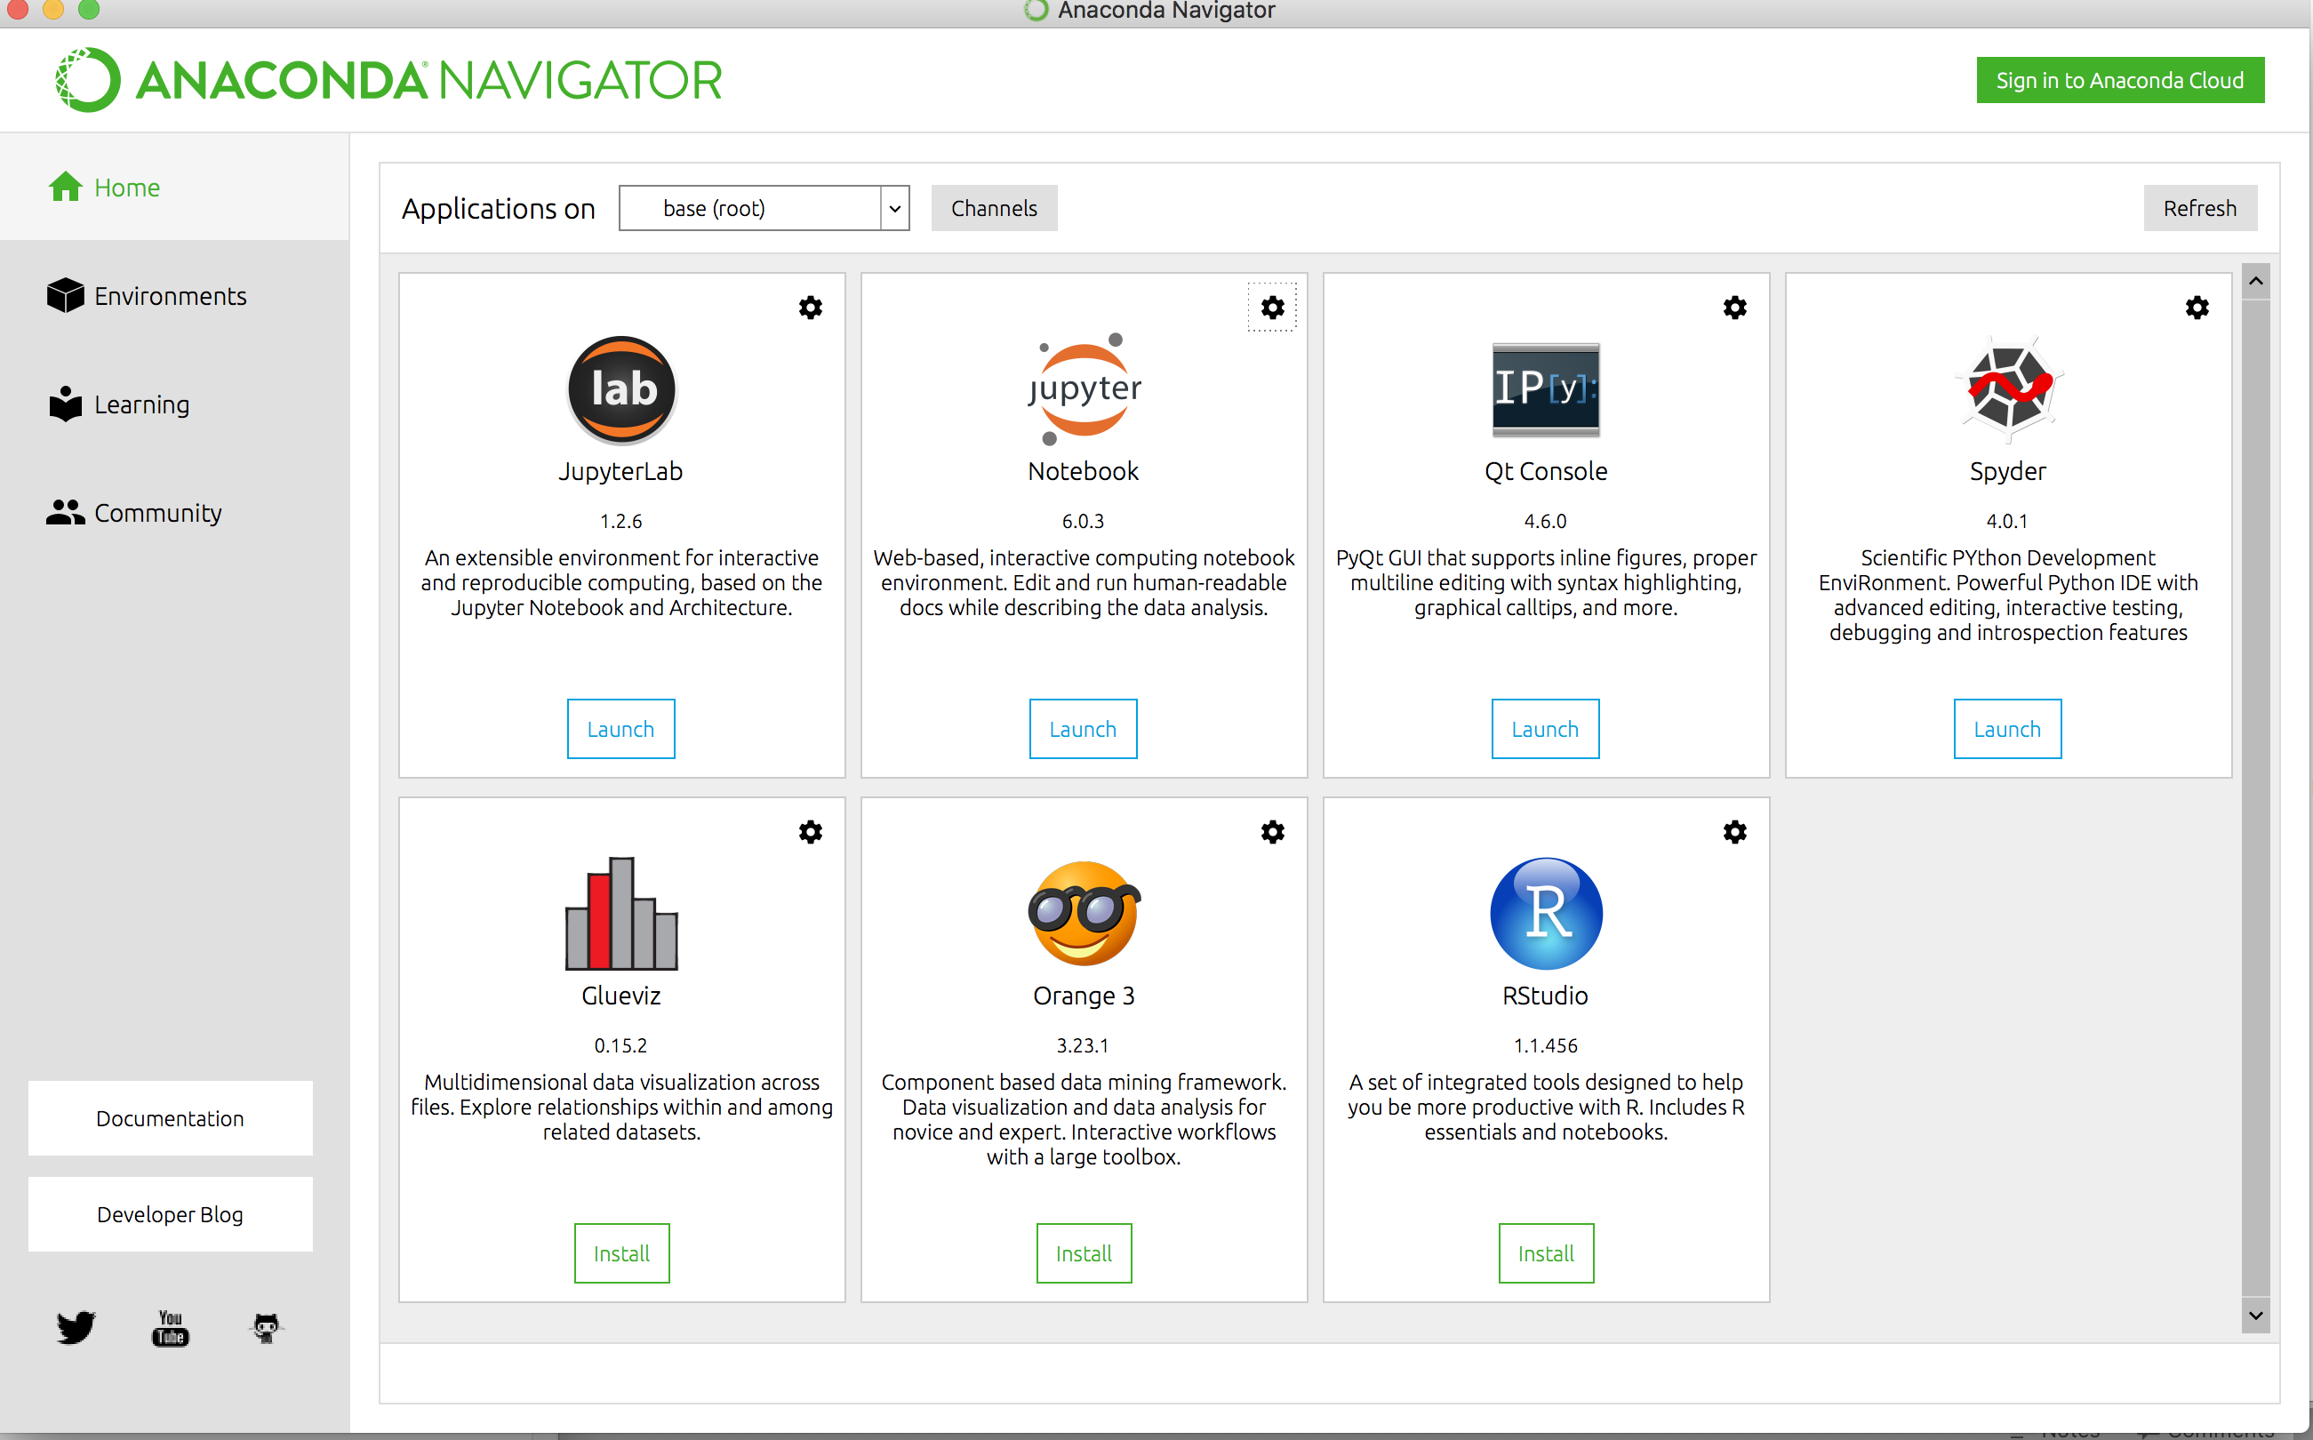
Setup: Installing Jupyter Notebook
The previous slide installed the packages we needed to use the GUI. We now want to install an easy to use code editor to be able to create python scripts for ourselves when we are looking to work with/plot the data in more complex ways that what the GUI is built for. Jupyter notebook is good for this
Install anaconda (choose 64 bit graphical installer for python 3.7): https://www.anaconda.com/distribution/#macos
Follow prompts until the main anaconda window is open
Go to terminal, type in
conda config --set auto_activate_base false
Restart terminal
You can now launch jupyter notebook from anaconda

Slide 8
Setup: Installing Packages
We now need to install the packages the GUI needs to be able to run. We will use python’s “pip” package manager to do this. In the terminal, paste the following command (each word after install is a separate package used in the GUI):
conda install cython fftw
pip install matplotlib numpy pandas scipy seaborn sklearn statsmodels tables git+https://github.com/jacoblevine/phenograph.git
xcode-select –install
pip install umap-learn --ignore-installed
pip install fitsne

Slide 9
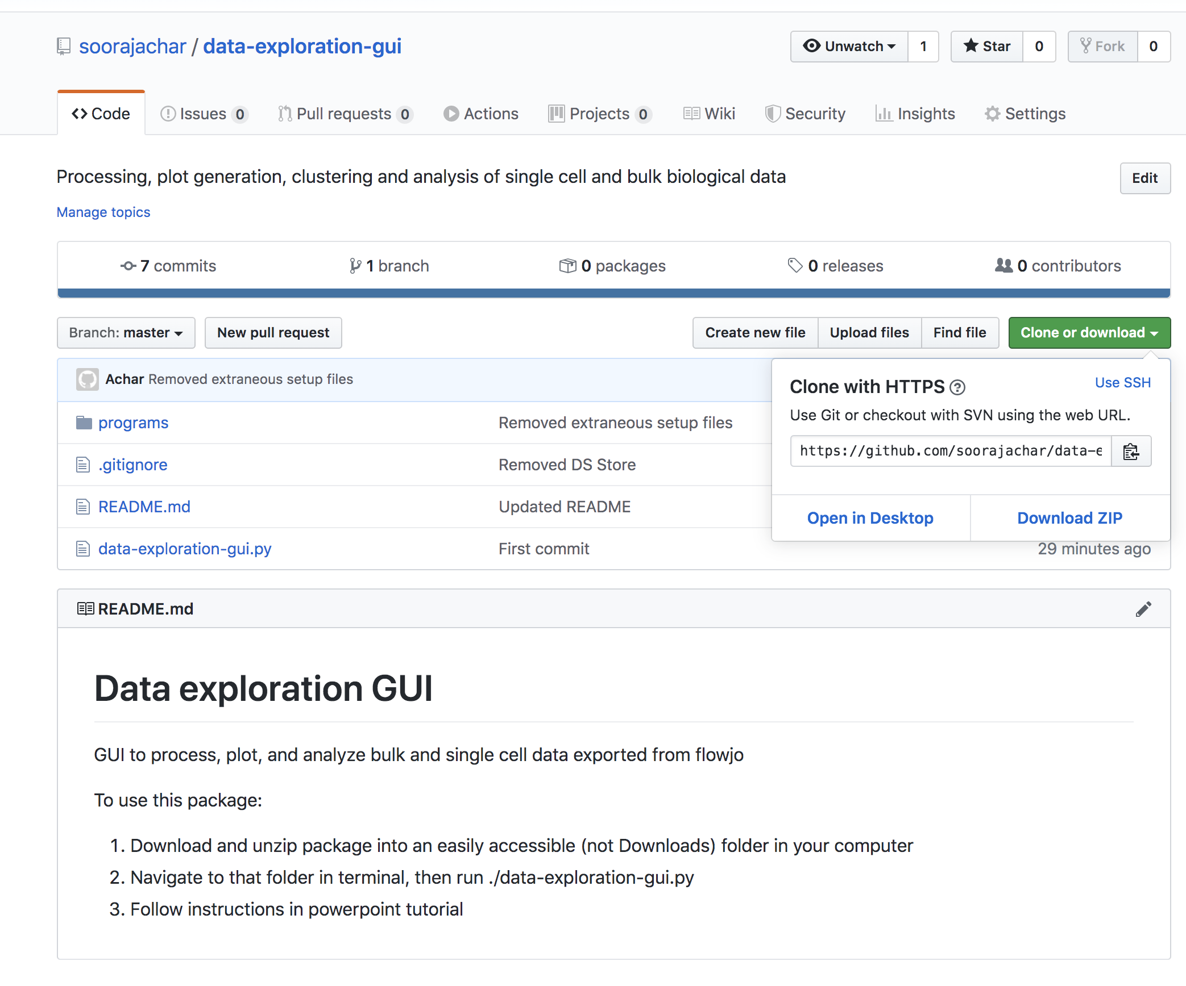
Setup: Downloading the GUI
Up to date versions of the GUI will be found here: https://github.com/soorajachar/data-exploration-gui
IMPORTANT: If I update the GUI, you will need to redownload it. Make sure that when you redownload it, you only replace the old “programs” folder with the new “programs” folder to avoid having to remake paths to your projects
Click this buttons on the github page to download the GUI:
(1)
(2)

Slide 10
Setup: Creating Projects
This GUI uses “projects” to organize experiments. These are simply an upper level folder that contains experiments. You can have multiple projects and add different experiments to each one depending on what they are about; this helps make it easier to find experiments.
You must have at least one project to start using the GUI

Slide 11
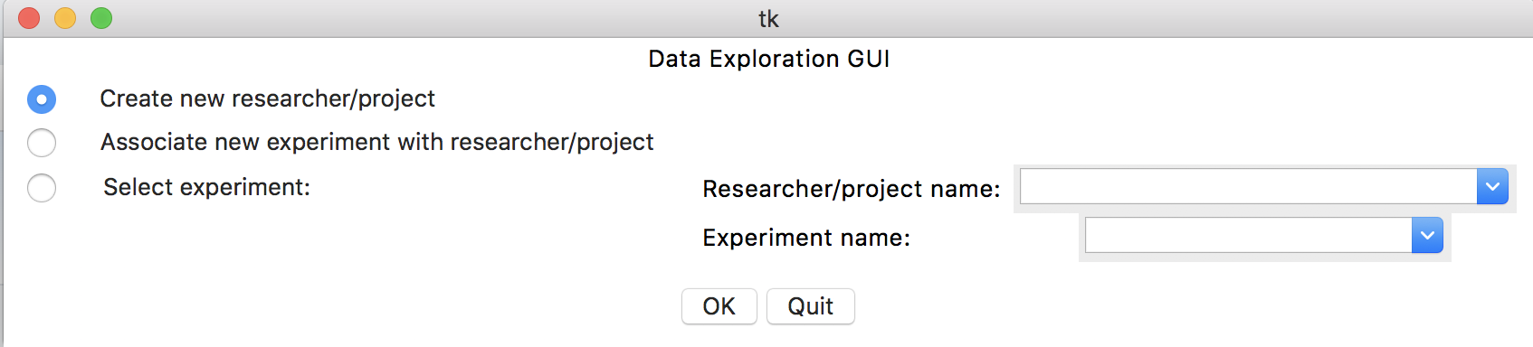
Setup: Creating Projects
To make a project, run the GUI, then select this radio button (1) and press OK (2):
(1)
(2)

Slide 12
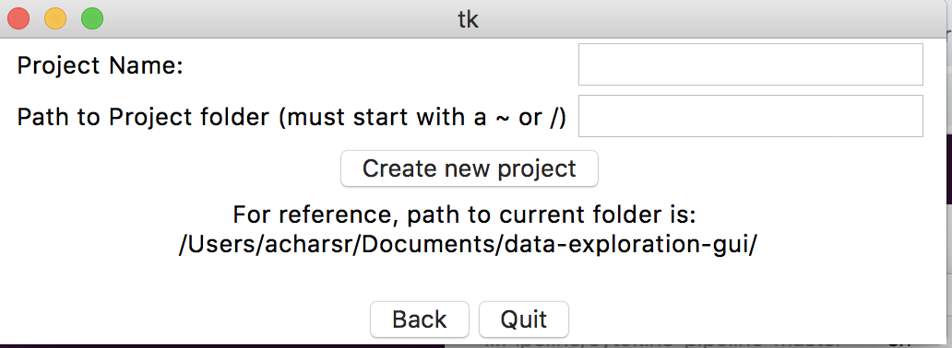
Setup: Creating Projects
Make a folder (preferably in Documents) where all of your projects will be stored. Call it something like “AllExperiments”
Navigate to that folder in terminal. Type in “pwd” to get the full path to that folder
Enter the name of the project you want to create in (1)
Enter the path you got from the terminal in (2)
Press ”create new project” button (3). Repeat for as many projects (NOT INDIVIDUAL EXPERIMENTS) you want to create. One will be enough for most people at this stage.
Press back (4) when done creating projects
(1)
(2)
(3)
(4)

Slide 13
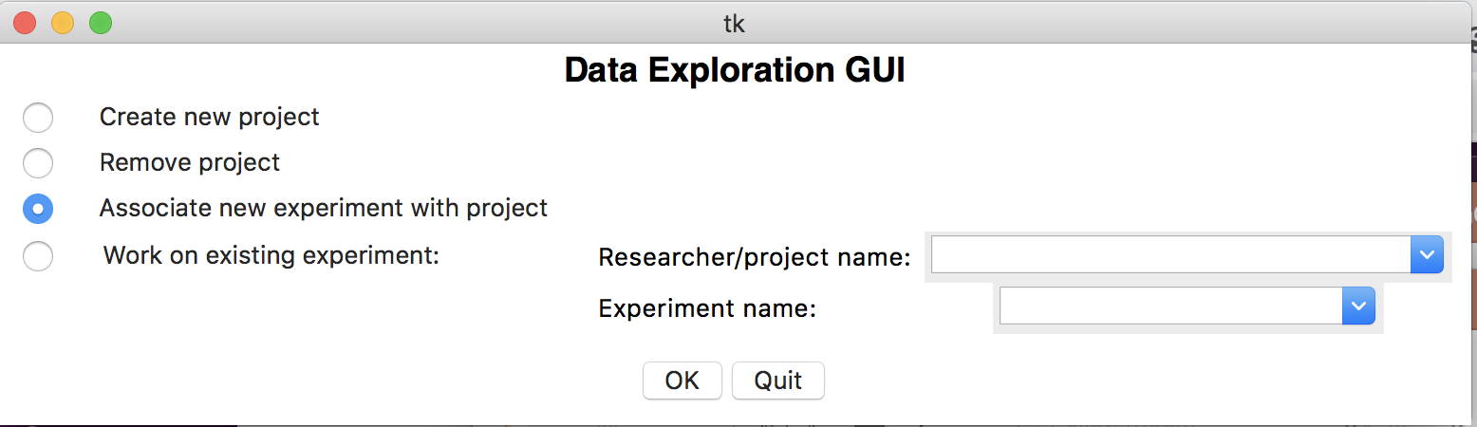
Setup: Creating Experiments
To create an experiment within a project, select radio button (1) then select OK (2)
(1)
(2)

Slide 14
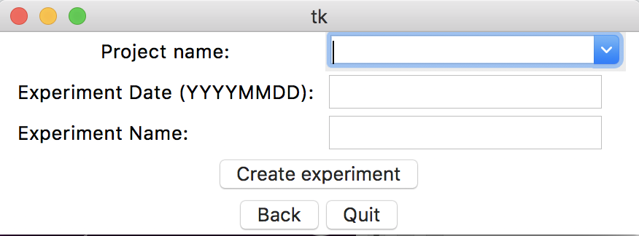
Setup: Creating Experiments
Choose a project name to associate the new experiment with from the dropdown
Enter the date of the experiment in the format specified (JUST NUMBERS) in
Enter the experiment name
Press the button called “create experiment”
Repeat for as many experiments as you want to create
Experiments folders will be saved in your project folder
To delete an experiment, simply delete its folder; in general you cannot delete things through the GUI
Do not rename an experiment manually unless you haven’t done anything with it using the GUI yet; instead make a new experiment with the new name and move all of the folders from the old experiment to the new experiment

Slide 15
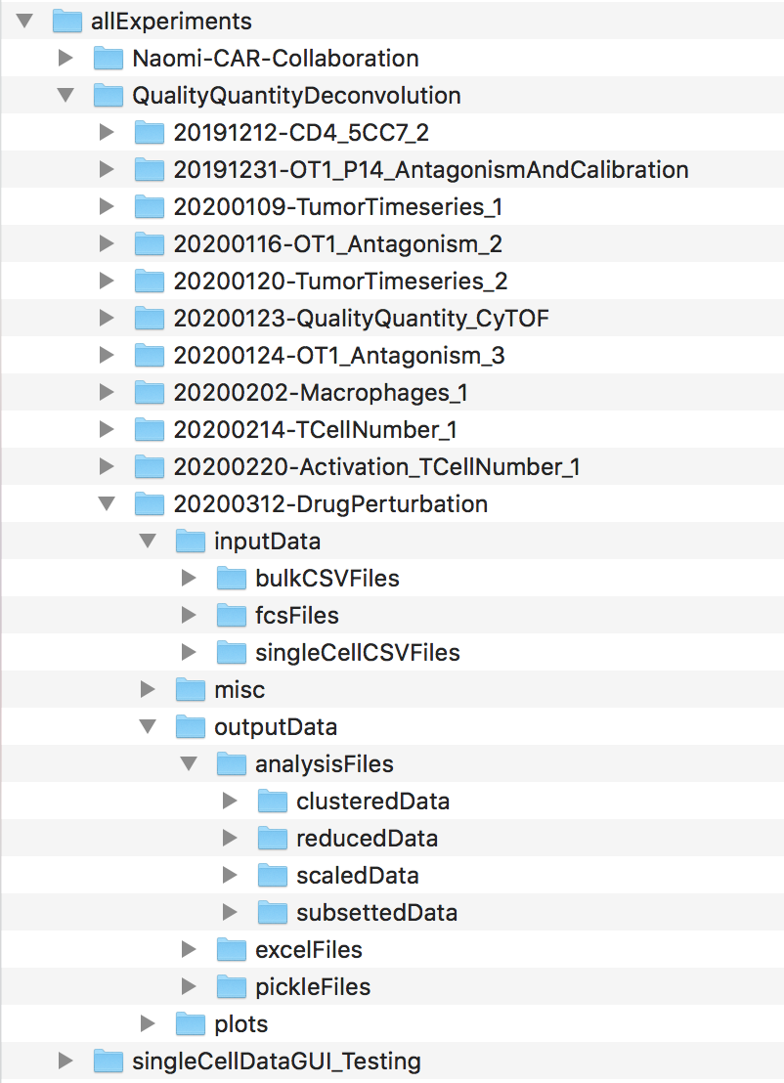
Setup: Empty Experiment File Structure
Name of folder that all projects are stored in
(created manually)
Project 1
This is the file structure of the GUI:
Project 2
Where you should put raw fcs files from flowjo as well as the workspace (this folder is not read by GUI so it’s optional, but is helpful to have them here for organization)
Experiments in Project 2
Data that is fed into the GUI
Where you should put single cell CSV files exported from Flowjo
Where you should put bulk CSV tables exported from Flowjo
Layout files for the experiment, sampleNameFile.xlsx, other random files
Where dataframes from various steps of single cell analysis for the experiment are stored
Output excel files
Output dataframes
Output plots
Project 3

Slide 16
Workflow: Adding Data
Do compensation + gating like normal in your flowjo workspace (ideally with all fcs files + workspace in the inputFiles/mics subfolder in your experiment)
Make sure to have a group specifically for samples, even if you only have one group, to make sure you exclude the compensation files from all exports
One important consideration when using the GUI:
All samples must have the same gates. It’s OK if the gates are shifted in position individually per sample, but the actual sequence of gates must be the same. It’s also OK if a gate is completely meaningless for a sample; it must still get it, even if no cells show up within the gate.
If you need different gates for different tissues for example, you must create separate experiments for each tissue

Slide 17
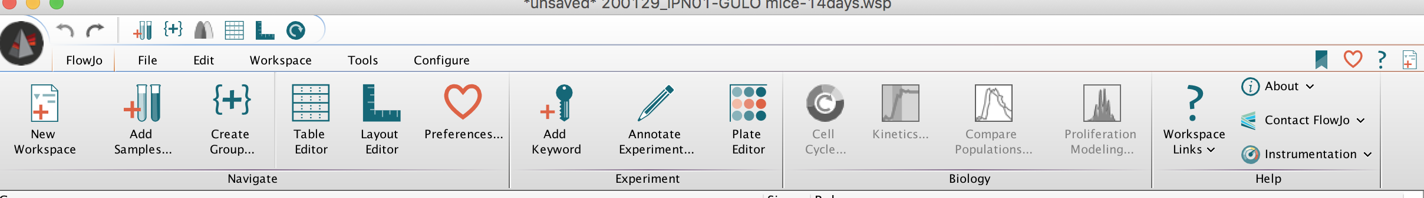
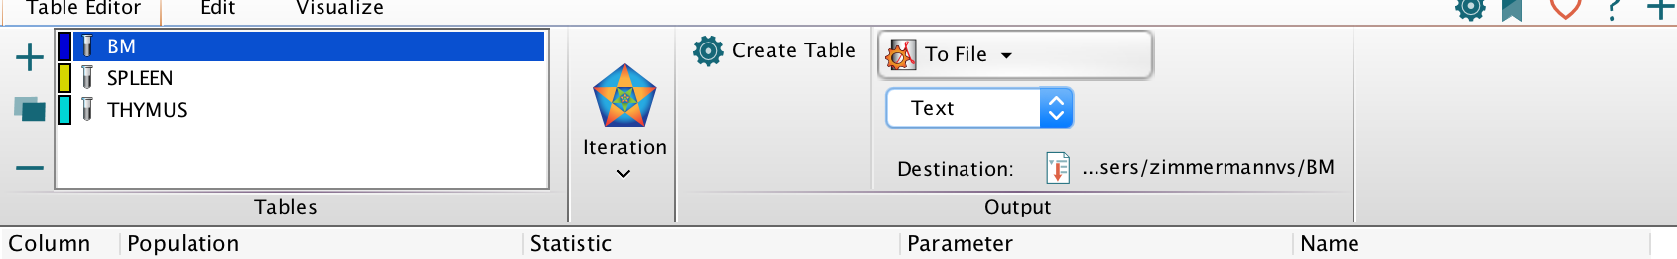
Workflow: Adding Data (Bulk: Tube)
Apply gates to all samples in your group like mentioned in the previous slide by dragging the gates to your sample group
Open the Flowjo Table editor:
Drag all statistics of interest to the table editor
Change dropdown (1) to “To File”
Change Dropdown (2) to “CSV”
Change destination (3) to inputFiles/bulkCSVFiles
You can name the file whatever you want
Make sure correct group (not all samples) is clicked (4)
Click create table (5)
(5)
(1)
(2)
(4)
(3)

Slide 18
Workflow: Adding Data (Bulk: Plate)
Same as tube, except you must have a separate group for each plate, and each specimen on the plate must have the default name from FACSDiva (Speciment_001_A01 etc.). This is important because the well ID is in the default name, which is needed to assemble the layout
Export each statistics table separately for each plate group by selecting (4) from previous slide
Name each table LetterNumber_cell.csv
Vary the Letter each time you have a plate with a new set of conditions (row plates)
Vary the Number each time you have a plate with a new set of timepoints (column plates)
For example, if I had a 48 condition experiment, where I used half a plate per timepoint, and I had four total timepoints, I would name my plates A1_cell, A2_cell
Conditions do not vary between plates, so only number is changed
If I had a 128 condition experiment, where I used 2/3 of a plate, across 2 plates, per timepoint, and had 3 total timepoints, I would name my plates A1_cell, A2_cell, B1_cell, B2_cell
The A plates have the first 64 conditions, repeated across three timepoints across 2 plates (A1, A2)
The B plates have the other 64 conditions, also repeated across three timepoints across 2 plates (B1, B2)

Slide 19
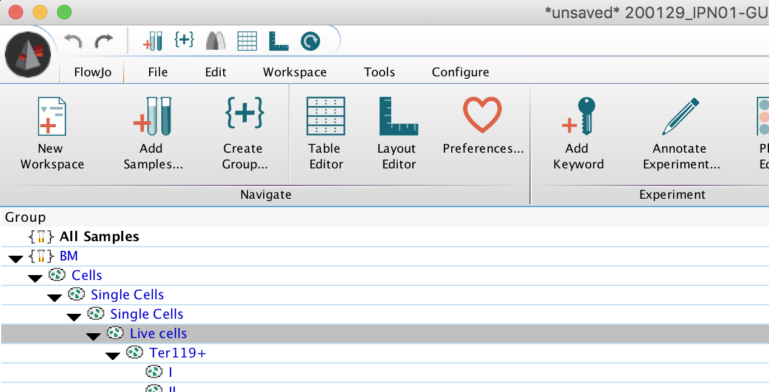
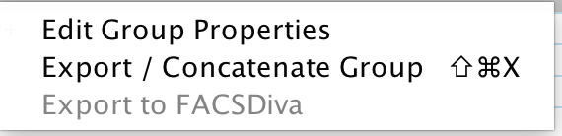
Workflow: Adding Data (Single Cell: Tube)
Right click on a population in a group without the compensation samples
Not an individual data file; the group (1)
Select ”export/concatenate fcs files” (2)
Note: If you modified the gate in the population you are exporting individually, you will have to export each file with modified gates individually (as flowjo won’t export their single cell csvs with the rest of the group). Other options:
Use a parent gate that is common to all samples
Make the gate broad enough to be repeated across the group
(1)
(2)

Slide 20
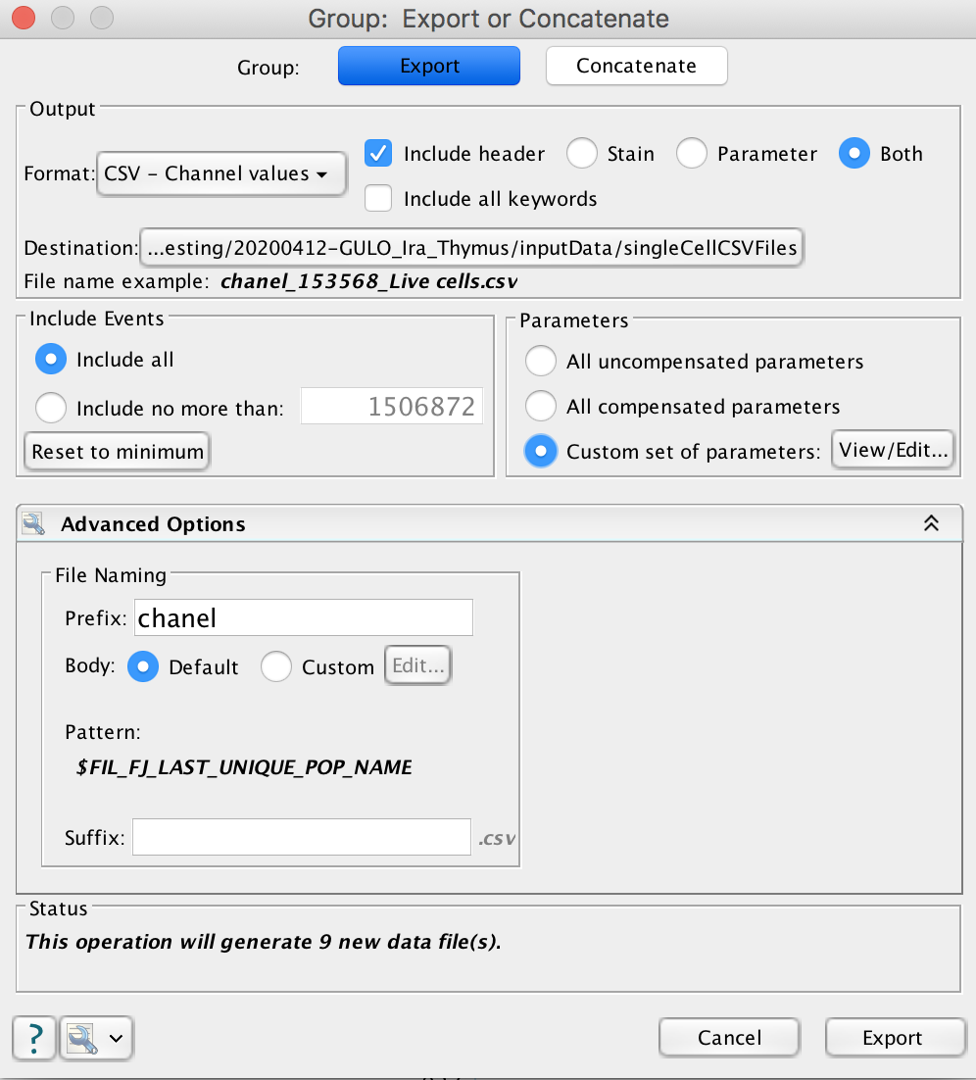
Workflow: Adding Data (Single Cell: Tube)
1) Change dropdown to “CSV Channel Values”
2) Select Both:
3) Select Custom parameters
4) Select view/edit include all compensated parameters and FSC-A/SSC-A (not the –H and –W parameters):
5) Change Destination to inputFiles/singleCellCSVFiles
If you have multiple populations you are exporting separately, you want to make folders inside of singleCellCSVFiles for each cellType and export appropriately
6) Change prefix “export” to channel:
7) Click Export; repeat for each separate cell type you want to export

Slide 21
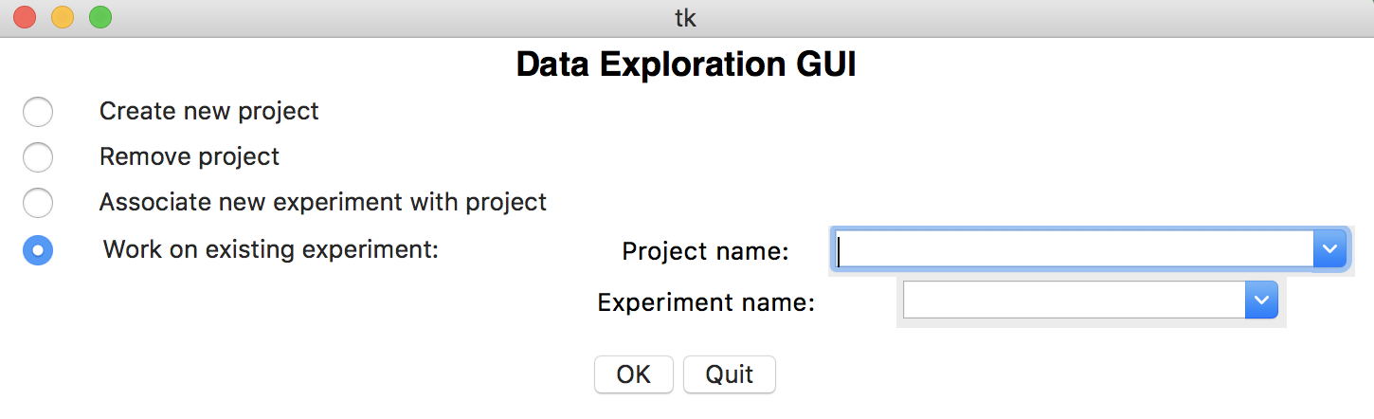
Workflow: Choosing an Experiment
You are at this point ready to start using the GUI
Begin by selecting the radiobutton (1), selecting a project in dropdown (2), and selecting an experiment in that project in dropdown (3), then press OK
You must do so in this order, as (3) only shows dropdowns from whatever project is currently selected in (2)
(1)
(2)
(3)

Slide 22
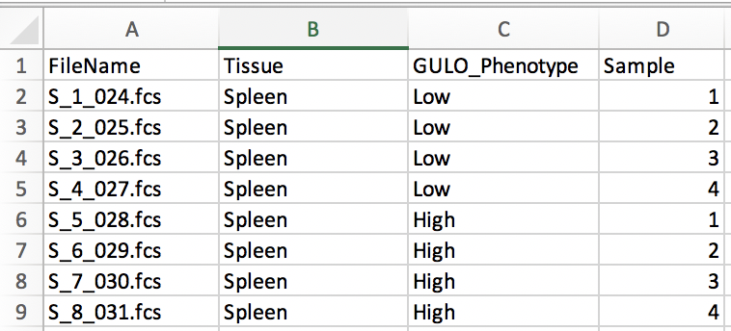
Workflow: Adding labels (Bulk or Single Cell: Tubes)
We now want to create labels for each sample you will put through the GUI
Create an excel file (which must be named sampleNameFile.xlsx) that contains labeling information for each sample fcs file. Use the format below. Each column is a different type of grouping, each row is a different fcs file. The first column must be called “FileName” the rest are specific to your experiment
No two rows can have the same sequence of columns, otherwise the samples would be though of as the same
Save the excel file inside of the “misc” folder in your experiment:
sampleNameFile.xlsx

Slide 23
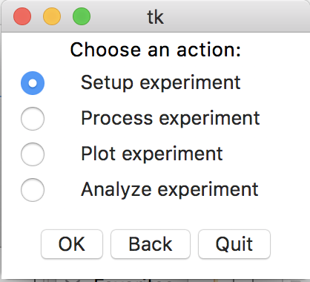
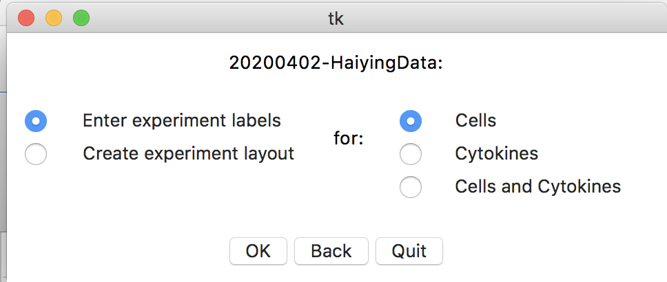
Workflow: Adding labels (Bulk or Single Cell: Tubes)
We then run the GUI, select the correct experiment as mentioned earlier, and then select “Setup Experiment” (1):
(1)
We then select enter experiment labels (2), and cells (3), and then OK
(2)
(3)

Slide 24
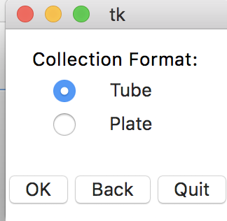
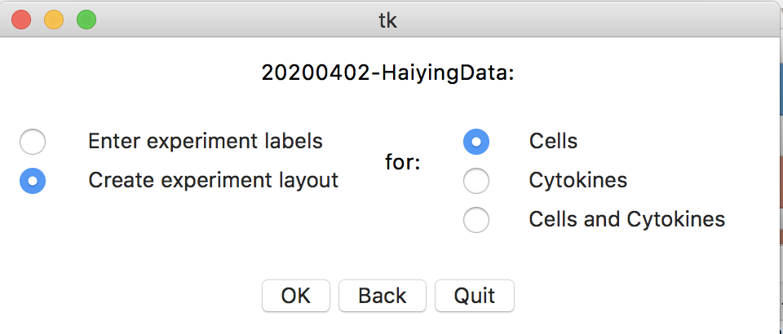
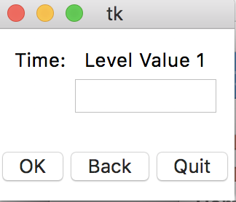
Workflow: Adding labels (Bulk or Single Cell: Tubes)
Select tube:
If you have made your sampleNameFile.xlsx correctly, everything should be autofilled from this point on and you can keep clicking OK until you get back to this window (1):
The one exception will be if you didn’t have a ”Time” label in your sampleNameFile, in which case you will only have one timepoint which you will need to fill in manually for your experiment with a number when you get to this window (2):
(1)
(2)

Slide 25
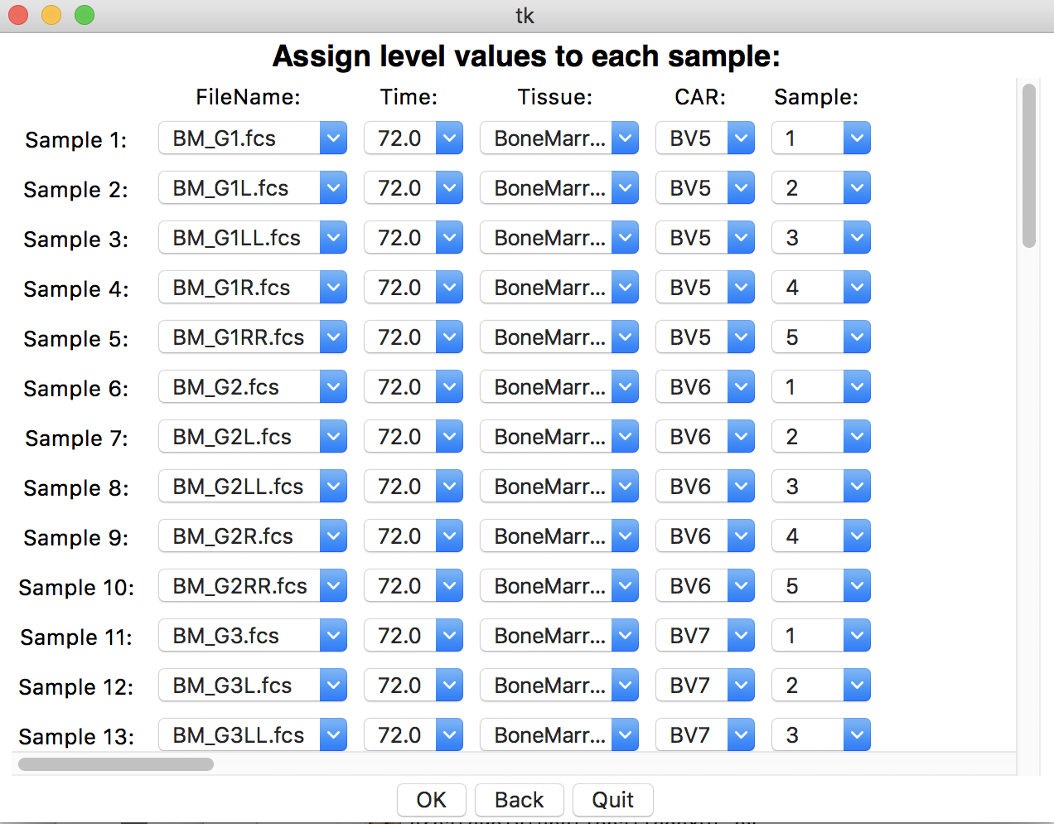
Workflow: Adding labels (Bulk or Single Cell: Tubes)
We then choose the options selected in this window (1):
(1)
(2)
Everything should be autofilled again in window (2), but you can make corrections here if something seems wrong. Then press OK

Slide 26
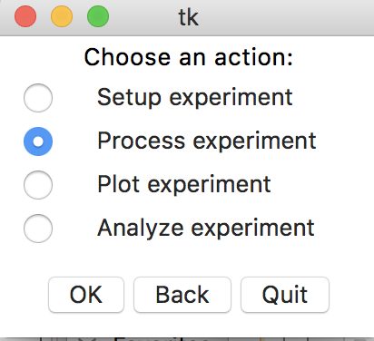
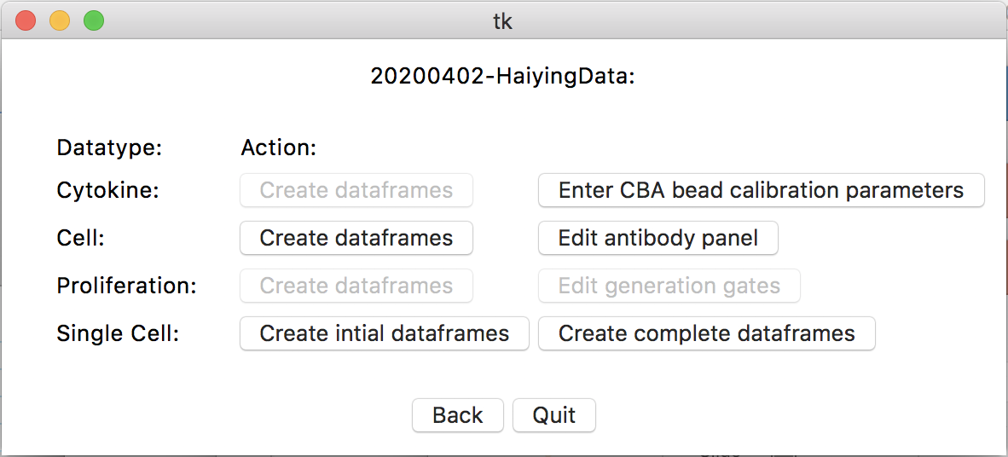
Workflow: Process Data
(1)
With the label data and the experiment data in the experiment folder; we can now use the GUI to create dataframes for further analysis/plotting
Press back to get back to window (1), where you now select the process option
In window (2):
If processing bulk cell data; select process bulk dataframes (3)
If processing single cell data; select process single cell dataframes (4)
Will take a while if there are a lot of cells
Should see the finished dataframe on your terminal window when processing is complete
(2)
(3)
(4)

Slide 27
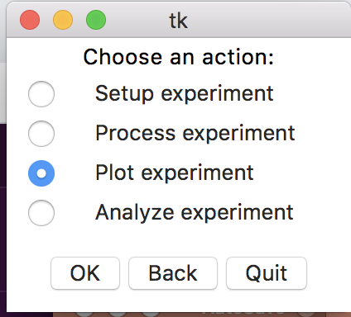
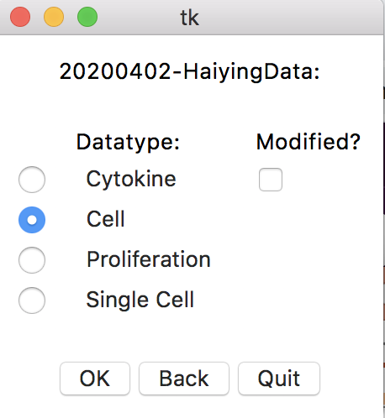
Workflow: Plotting
Now that we have created single dataframes of our bulk and/or single cell data, we can start plotting the data through the GUI.
First, select back, then select the plot option from the main action window:
Then select either the “Cell” option if plotting bulk cell data, or the “single cell” option if plotting single cell data (I will be plotting bulk data)

Slide 28
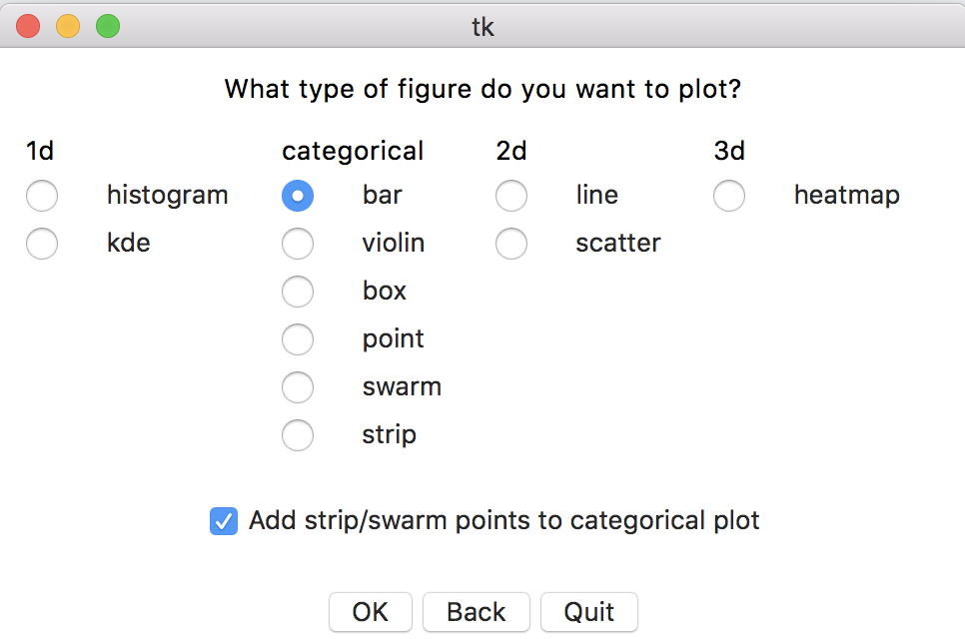
Workflow: Plotting
Then select the plot type you want (I will be plotting a barplot)
Single cell plotting only works with 1D or 1.5D (categorical) plots right now. I hope to add support for 2D plots in the near future
Bulk cell data can be plotted with any type of plot
Checkbox (1) is used to add the individual data points to a categorical plot (like a bar plot)
(1)

Slide 29
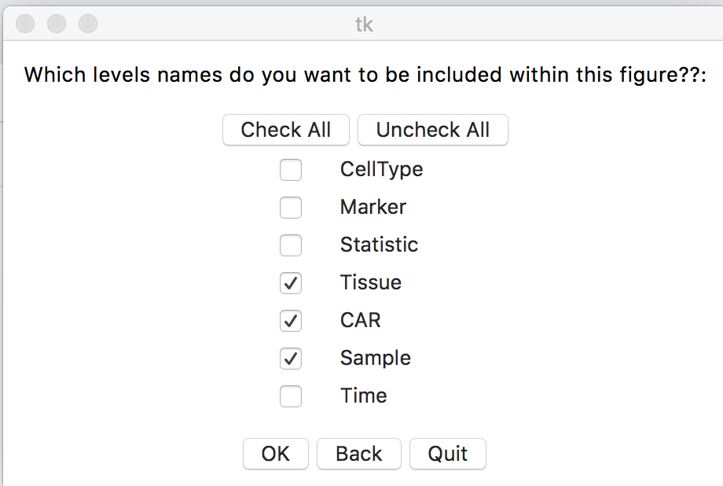
Workflow: Plotting
This next window is probably the toughest to understand. Essentially, in this window, you will select each level (group) that you want to include in each figure. If you don’t have a level selected, if the level has multiple level values, you will get a separate plot for each of those level values
In the picture to the right, I’ve unchecked all levels except for Tissue, CAR, and Sample. This means that I will assign the tissue, car, and sample levels to parameters in a barplot (like x,column,order). Every combination of the other levels will be plotted in separate plots
If I had unchecked Tissue as well, I would have twice as many plots, as now each tissue (there are two total) would also have a separate plot

Slide 30
Workflow: Plotting
It’s important to keep in mind that the first three levels (in bulk cell data): CellType (a.k.a. Population), Marker, Statistic, are added during processing
You should never check the statistic level here; each statistic should always be plotted separately
Also keep in mind that if you only have a single level value in a level (like in this dataset, where we only have one timepoint) it’s good to keep it unchecked

Slide 31
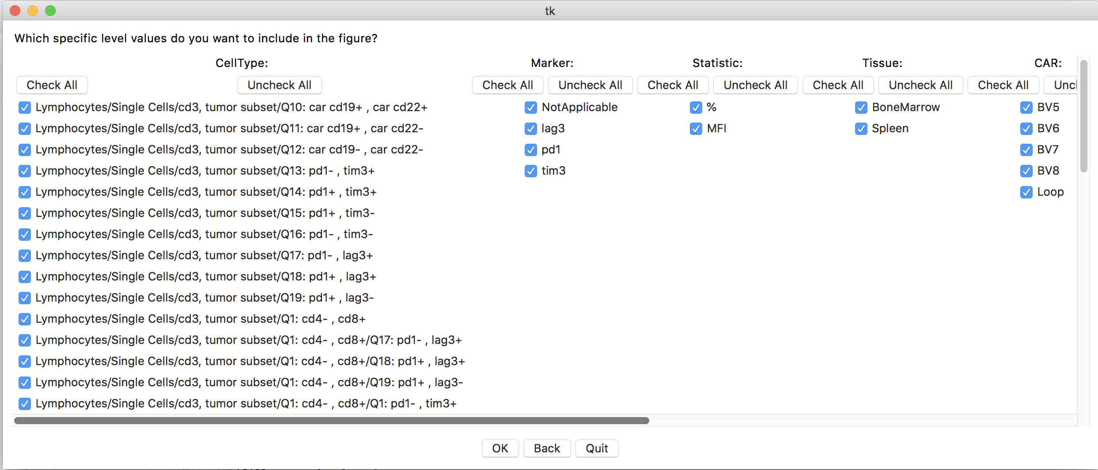
Workflow: Plotting
The next page is pretty straightforward; you simply select the level values you want to include in your plots
You can use the scrollbars to move the pane around
They can glitch out and not move sometimes; if that happens just press back, redo the previous window, and try again
Making sure you release the cursor on the scrollbar while it is still on the scrollbar seems to help, as does scrolling somewhat slowly
You can use the check/uncheck all buttons to check or uncheck all level values in a level
I have everything selected, so I will be plotting all of the bulk data at once (usually not recommended as it can be tough to go through all of the file names)

Slide 32
Workflow: Plotting
Different plot types have different parameters available in this window
The general idea in this window is to assign a different plotting parameter to each level you have selected to include in a figure
Color means the color of this level will change across its values
Style means the type of marker of this level will change across its values
Size means the size of the markers of the level will change across its values
X axis values means that this level will be plotted across the x axis (2D/heatmap)
Must be assigned in 2D plots
Must be assigned to at least one level in heatmaps
Order means that this level will be plotted across the x axis (categorical)
Must be assigned to one level in categorical plots
Y axis means that this level will be plotted across the y axis (heatmap)
Must be assigned to at least one level in heatmaps
Row means that each level value in this level will be plotted in a different row of subplots
Column means that each level value in this level will be plotted across a different column of subplots
None means that this level will not change across the plot. Use this parameter on levels that only have one value that you forgot to exclude earlier or on levels whose values you want to plot together (aka replicates)
You cannot assign one parameter to multiple levels (except for x/y axis in heatmaps)

Slide 33
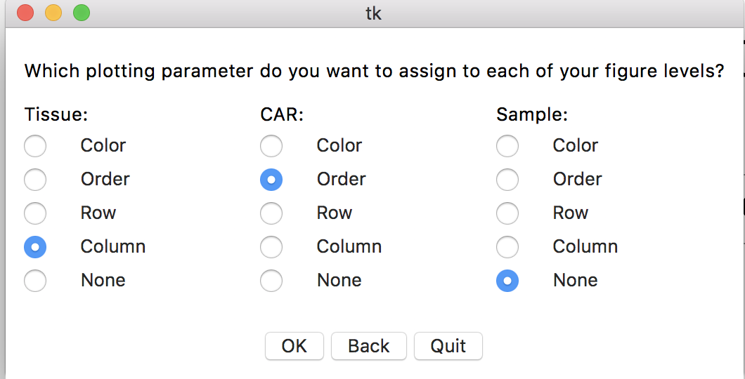
Workflow: Plotting
Here, our choice of parameters means that the CAR type will have a different bar for each CAR across the x axis, there will be two column subplots for the two tissues, and that our samples will all be plotted as individual data points on each bar

Slide 34
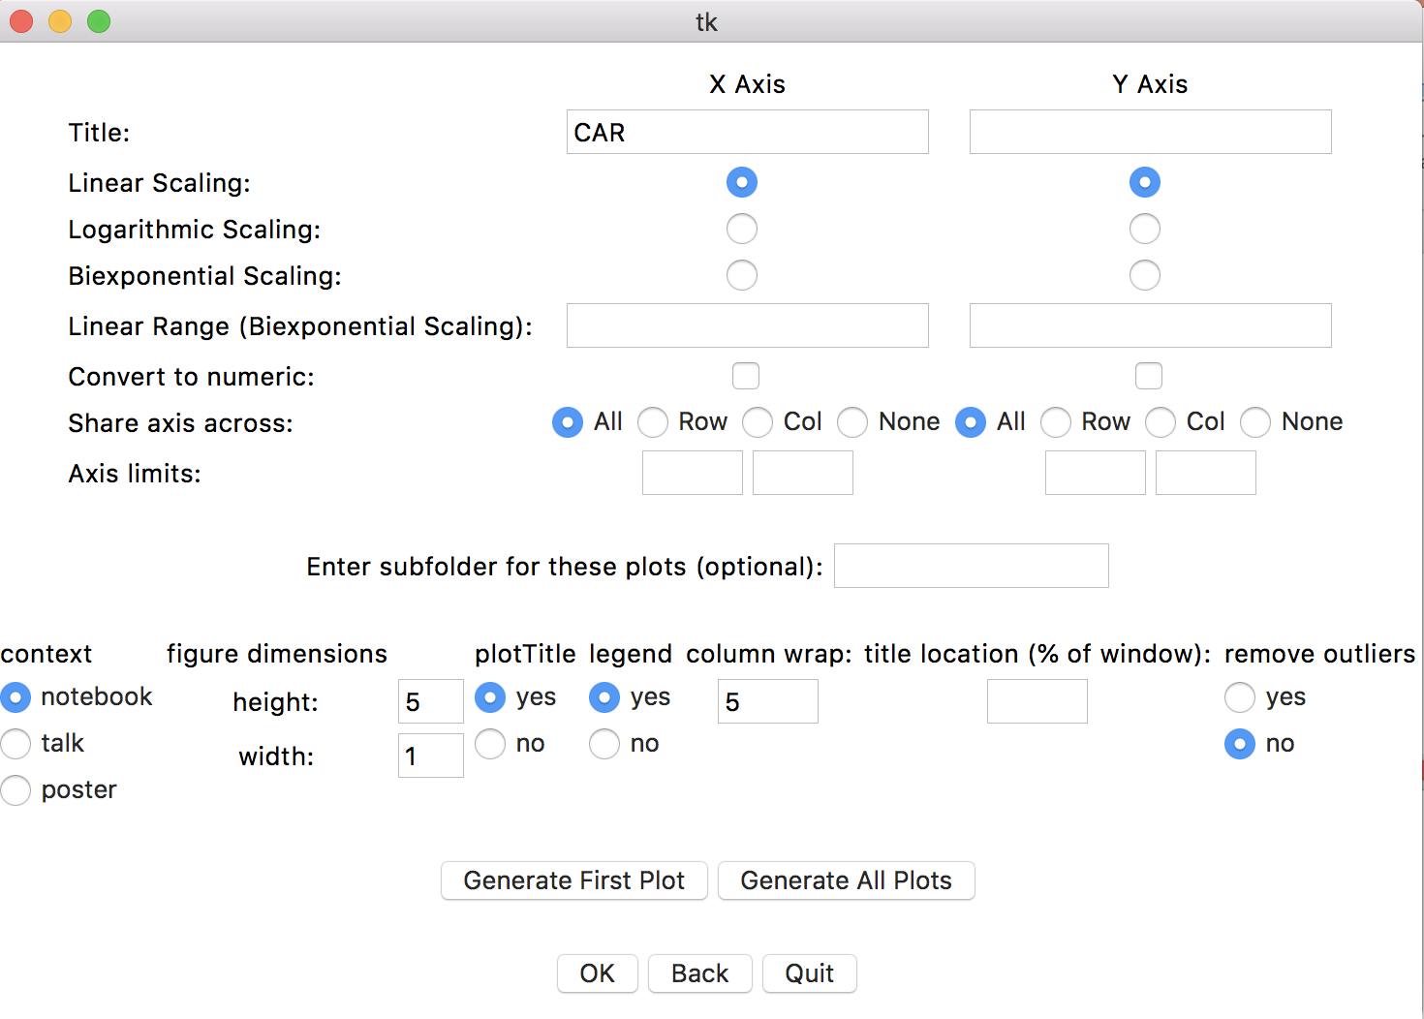
Workflow: Plotting
Most plotting options here are pretty self explanatory; I will label the less intuitive ones:
Where to share axes; if row is selected, each y axis will be shared across each row etc.
Upper and lower bounds of axis limits per axis
Important: Creates a subfolder in the ”plots” folder of your experiment with whatever title you put in. Important to avoid clutter when creating many different types of plots. If blank, will save within ”plots” folder itself
Sets thickness of lines/points on plots
Decides how many plots to plot in one row before wrapping to the next row (if only column is selected in the previous window)
Important: Generate the first plot “called temporaryFirstPlot.png”. Open it to see if you need to make more adjustments. Will eventually be part of this plotting window itself
Important: Generates all plots; press when you have finished fiddling with the plotting parameters
ONLY PRESS WHEN YOU ARE DONE PLOTTING OR WANT TO RESTART THE SELECTION PROCESS
(1)
(2)
(3)
(4)
(5)
(6)
(7)
(8)

Slide 35
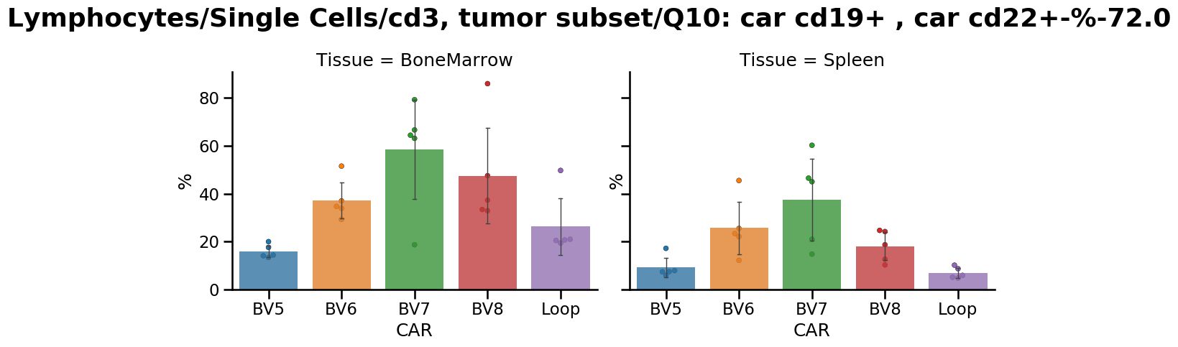
Example of plot generated:

Slide 36
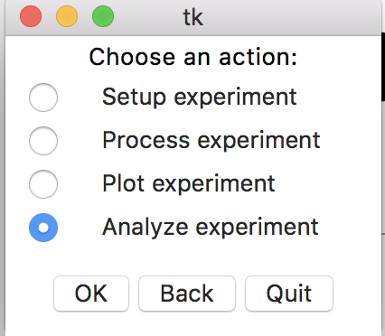
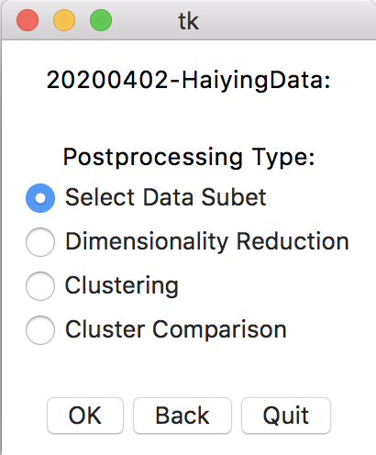
Workflow: Analysis
We can also analyze our data by clustering (especially useful for single cell data) by selecting the “Analyze Experiment” option in the main action window
We need to go through each of these four steps in the right window in order, starting with “Select Data Subset”:

Slide 37
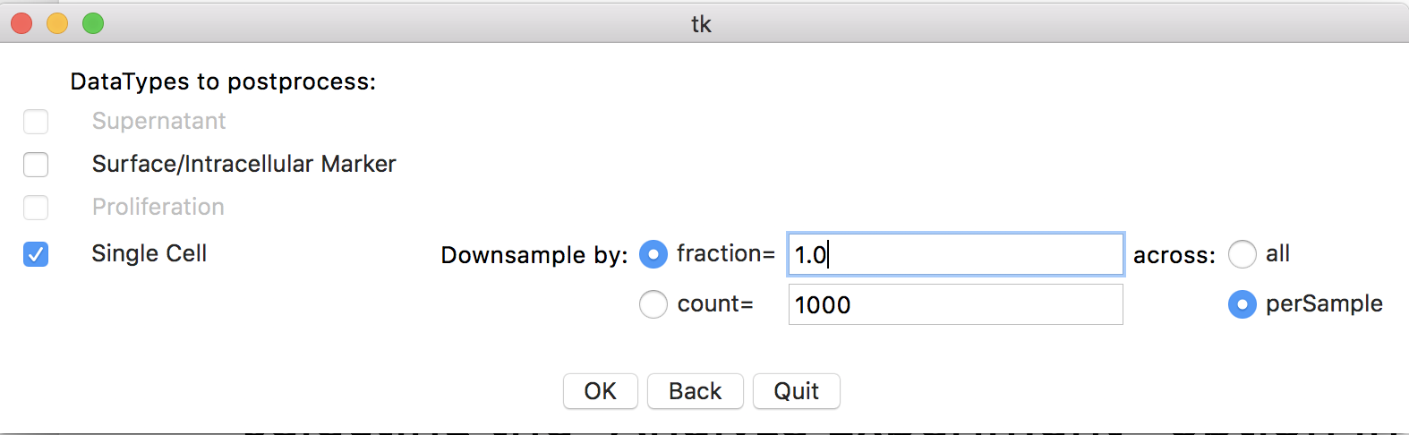
Workflow: Analysis
We start by selecting the dataframe we want to subset using the checkboxes on the left (single cell in this case)
We can then select if/how we want to downsample. You can downsample by a percentage or a maximum count either per sample (.fcs file) or across the whole dataset.
To keep all of the sample, set fraction to 1.0 like we do here
In general, try to keep dataset sizes to 100k rows or less if you want things finished in a reasonable amount of time. Larger sizes are possible but will take longer to cluster/reduce dimensions
I prefer downsampling per sample as it ensures every sample shows up at least somewhat in the subset

Slide 38
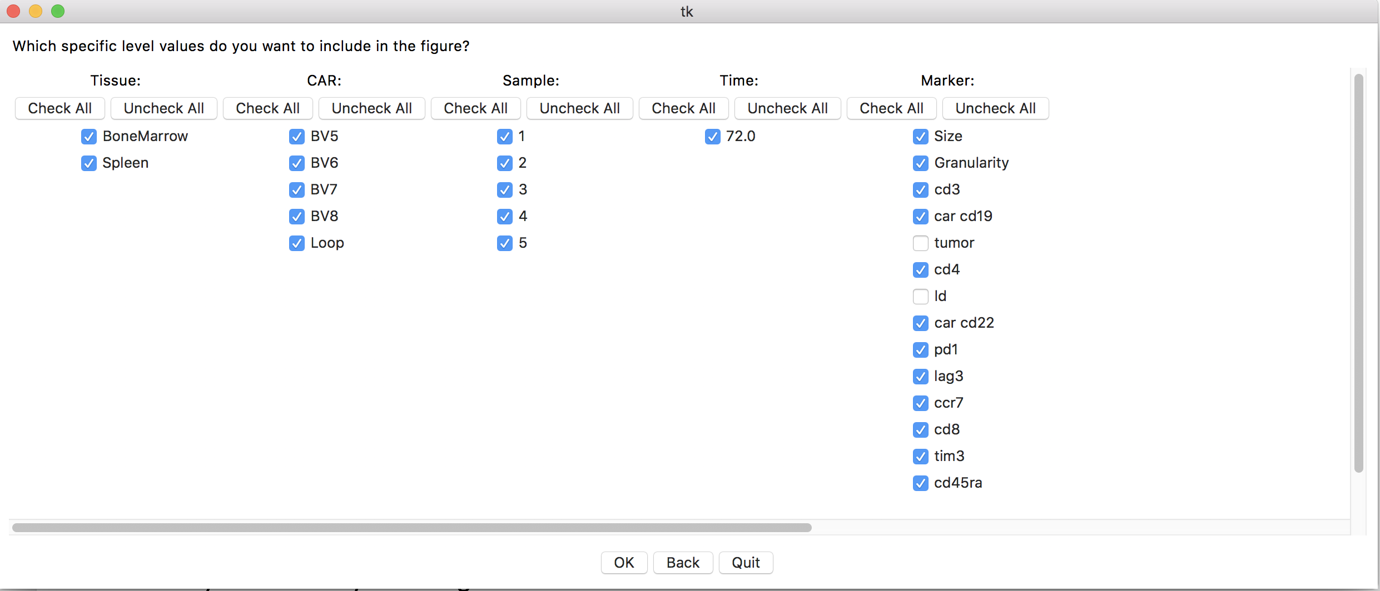
Workflow: Analysis
This window is the same as the plotting window, where you can select which level values to include in your subset
Pay attention to which dimensions (Markers) you decide to include when working with single cell data. Removing noisy markers, markers that vary very little, or markers that have already been used to gate the population (like live/dead for example) can help make further steps faster as they won’t add any extra information to your analysis but still slow down the processing steps
You’ll notice that I unchecked live/dead and tumor from the dimensions in this subset, as they were already used to gate out the cells that I am selecting in this subset and therefore will be very homogenous across the cells, making them useless for clustering

Slide 39
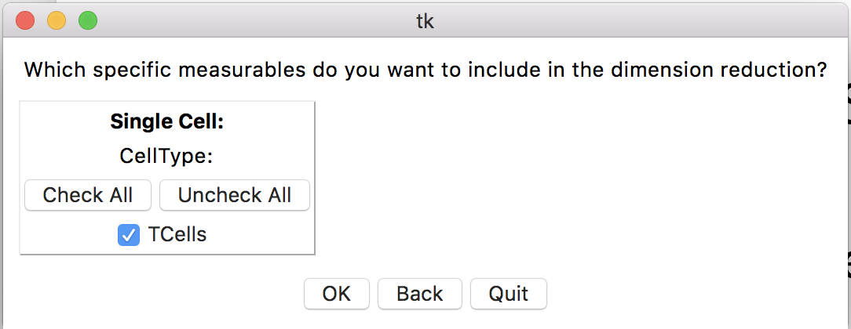
Workflow: Analysis
Here you want to select the dimension types added by the processing to include in the subset. Not very useful for single cells, but can sometimes be useful when clustering bulk data

Slide 40
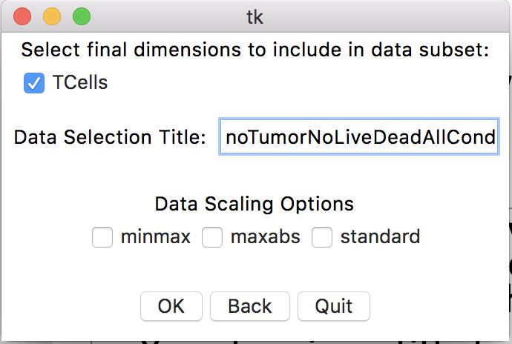
Workflow: Analysis
Here you select the level combinations of the processing added levels to include (can again be sometimes useful for bulk data, not so much for single cell data)
You also give a title for your subset; make sure to make it descriptive enough to differentiate it from other subsets you make
You’ll notice here I decided to put the markers I excluded along with the subset in the name
The downsampling parameters will automatically be added to the end of the name so you don’t need to mention those
Finally you select the scaling type. With single cell data, you generally do not need to scale the data at all, as it has already gone through a biexponential transformation in flowjo (as you exported channel values), so I usually uncheck the min/max box. It can be helpful to scale by one of the scaling types with bulk data however

Slide 41
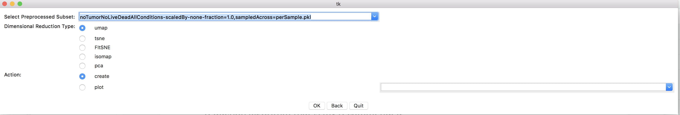
Workflow: Analysis
We then select the dimensional reduction method (2) as well as the subset of data to perform the dimensional reduction on (1) with the dropdown. You will be able to select any dataset you have gone through the previous subsetting step with. This is why it’s important to select a descriptive name!
Umap is a good general purpose dimensional reduction algorithm that is my recommended choice for visualizing single cell data
If you do want to use tSNE, I recommend using fITSNE (a sped up but slightly less accurate tSNE) if the dataset has more than about 50k cells, as tSNE becomes horrendously slow otherwise
PCA can be good for simple bulk datasets
The create option in (3) is what you generally should be picking to create a dimensional reduction; the ”plot” option is if you want to go back and replot a dimensional reduction you’ve already created
If you do select “plot”, make sure to pick the dimensional reduction you want to replot using the righthand dropdown menu (4)
It’s blank here because I am pressing create, so I don’t need to use the righthand dropdown
(1)
(2)
(3)
(4)

Slide 42
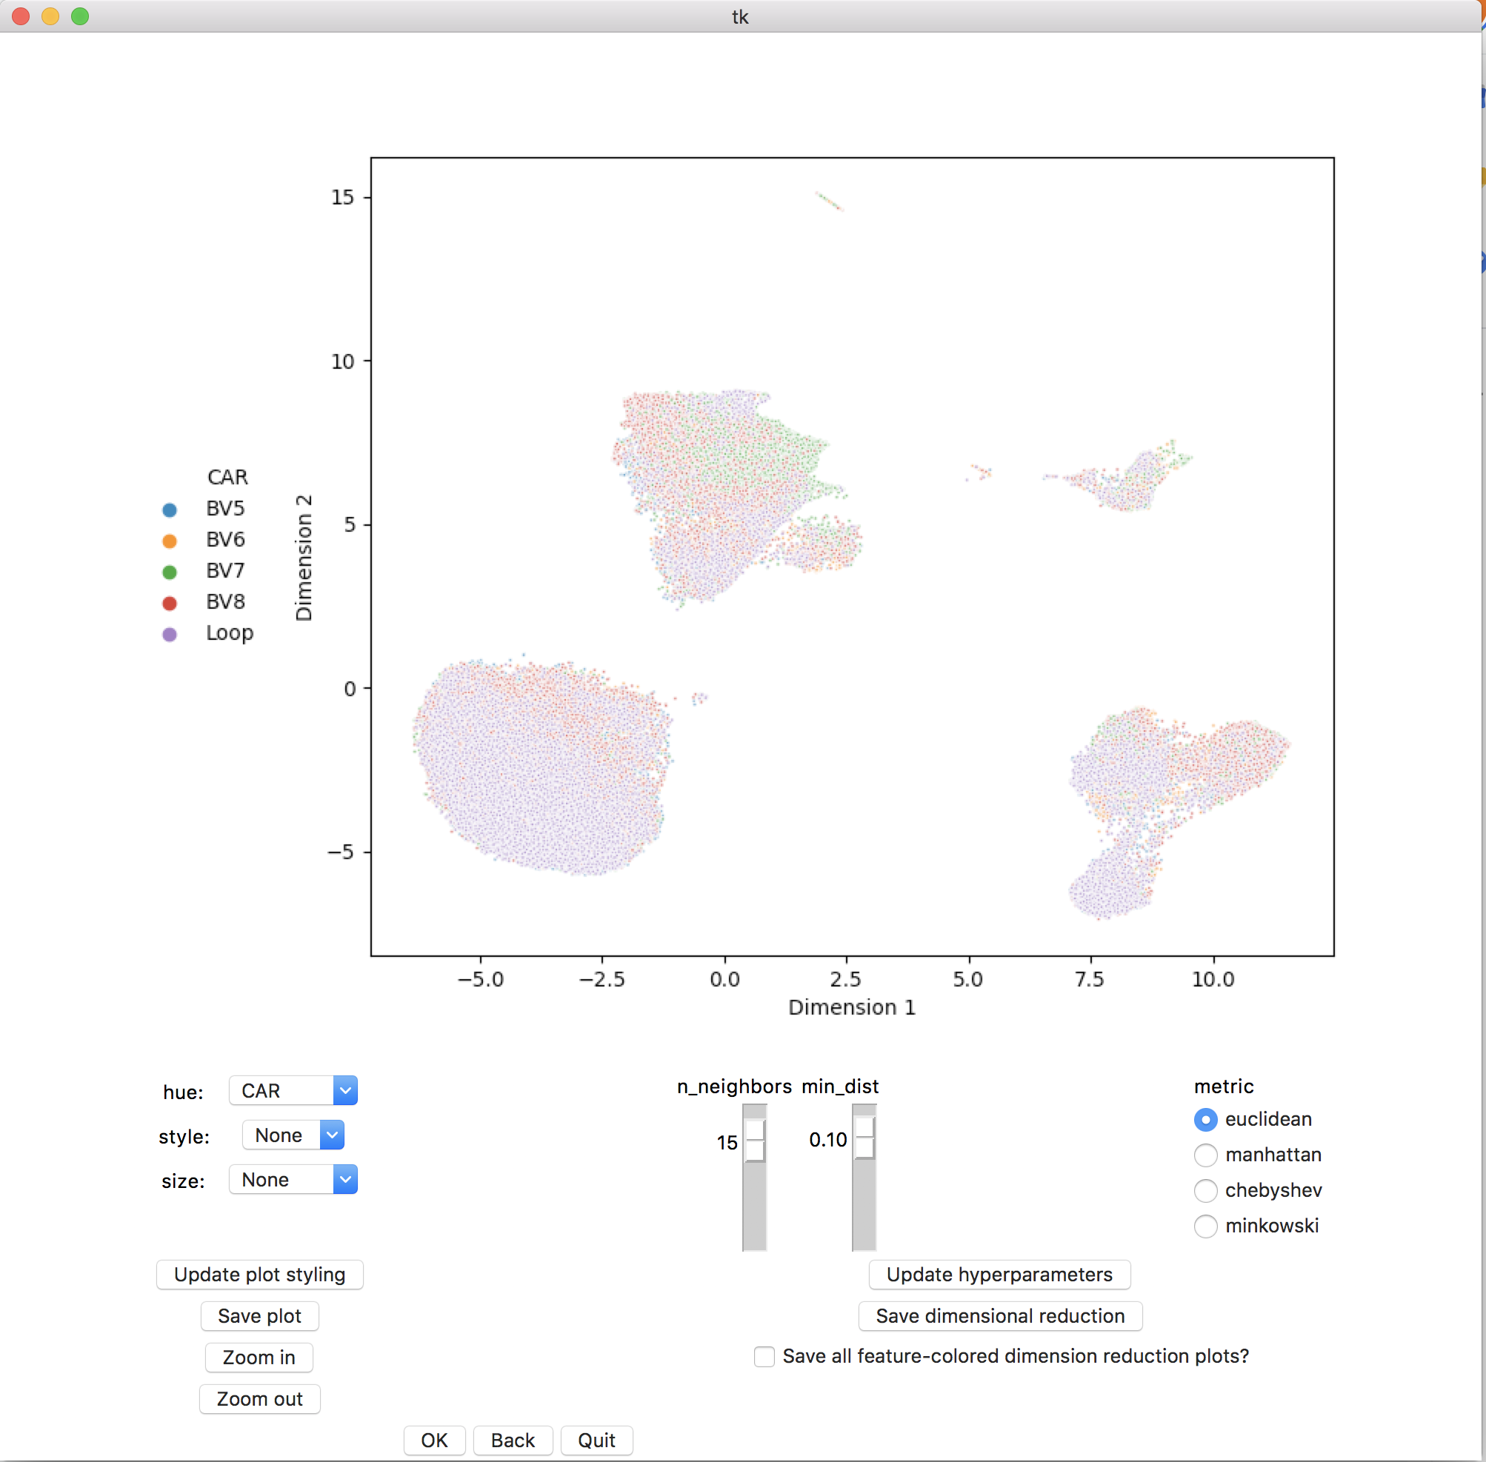
Workflow: Analysis
After some time (depending on how long your dataset takes to reduce dimensions) you will be greeted with the page on the right
You can modify the way the dimensional reduction is shown using the dropdowns on the left to see if it makes sense (1)
Change which levels are assigned to which parameters in the dropdown, then press “update plot styling” (2)
You can modify the hyperparameters used to create the dimensional reduction using the sliders/radiobuttons in (3), then pressing “update hyperparameters”
I only recommend doing this if you are working with bulk datasets (which are small). It takes too long to rerun a dimensional reduction otherwise
When you are satisfied with the dimensional reduction, you can press “save dimensional reduction” (4)
If you have the box in (5) checked, a plot of the dimensional reduction colored by each feature (cell markers in the case of single cell data for example) will be generated and saved under a single folder in your plots subfolder
This takes a bit to finish, but can be useful
IMPORTANT: Only press (6) (the OK button) when you have saved your dimensional reduction in (4) or are not satisfied with it and want to restart
(1)
(3)
(2)
(4)
(5)
(6)

Slide 43
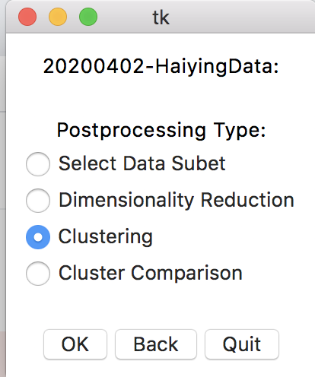
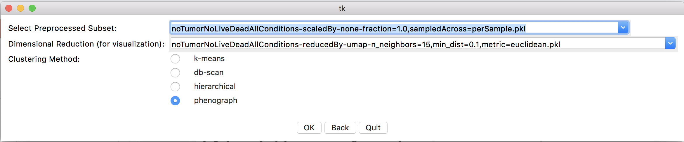
Workflow: Analysis
We now move onto clustering:
In the next window, much like the dimension reduction window, we can choose the data subset in (1), and the clustering type in (3). I will add support for more clustering types in the future, but for now use phonograph for single cell data, and kmeans/hirerarchical/db-scan for bulk data
You also need to select the dimensional reduction to visualize your clustering on in (2). The dimensional reduction chose plays no factor in the calculation of your cluster, as that is done on the full dataset (without reduced dimensions), so feel free to pick any reduction you’ve made with this data subset
(1)
(2)
(3)

Slide 44
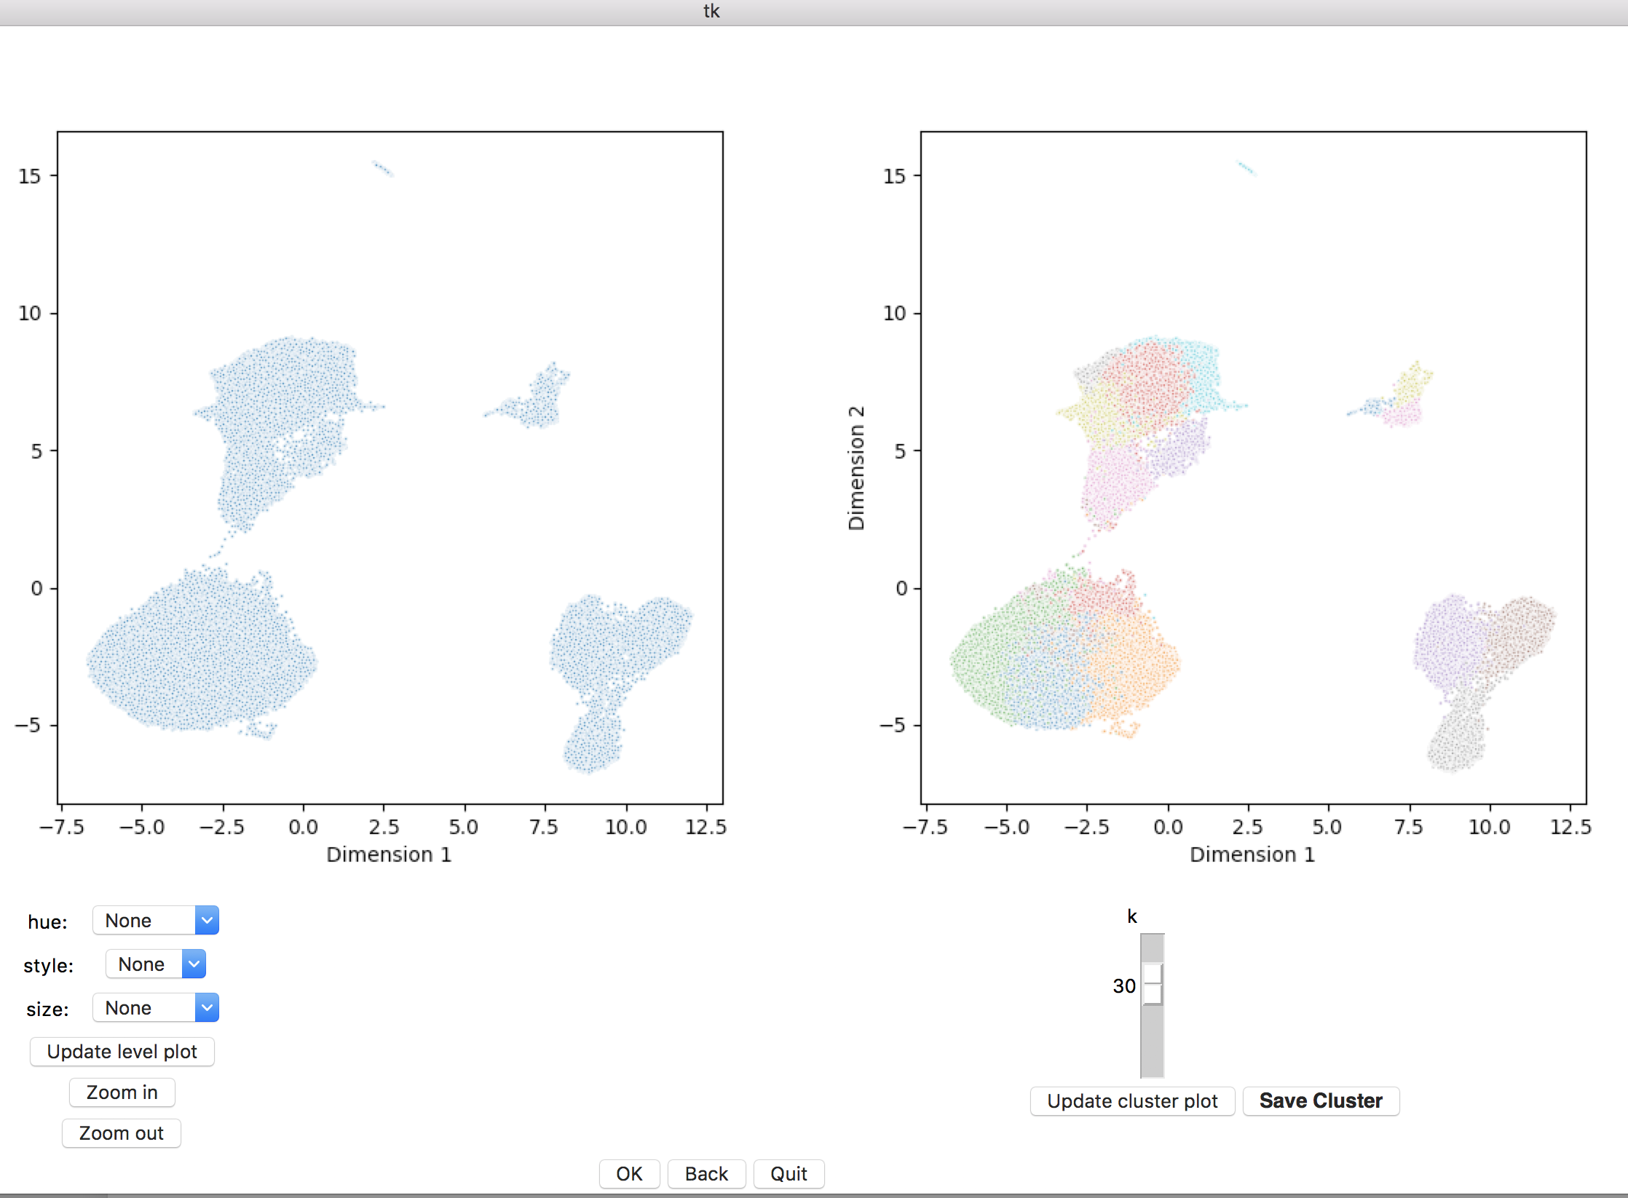
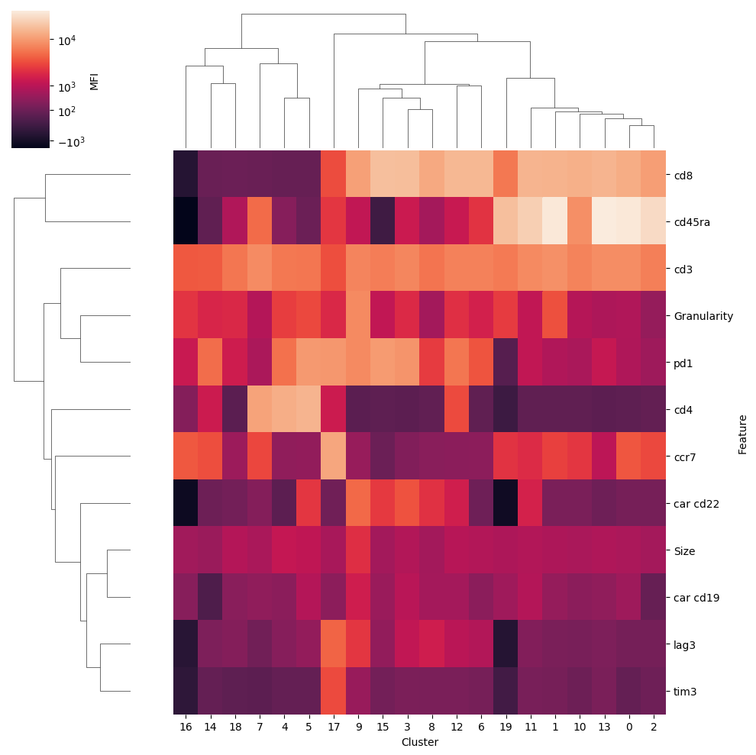
Workflow: Analysis
Clustering end window is very similar to the dimensional reduction end window.
You can adjust visuals in (1), adjust clustering hyperparameters in (2) (only do for non single cell data), and save the cluster in (3)
Again, DO NOT press the OK button (4) until you’ve either saved a cluster you are happy with or want to restart the clustering process
When you save a cluster, you also make a cluster vs feature clustermap that is saved in the plots subfolder that can help you look at the features of each cluster at a glance (5)
(1)
(2)
(4)
(3)
(5)

Slide 45
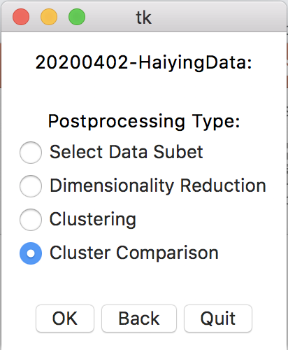
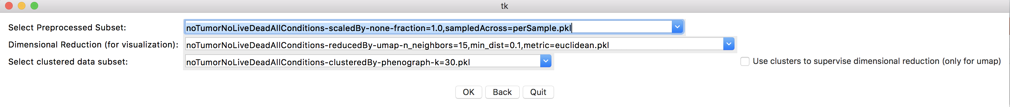
Workflow: Analysis
Final step: comparing clusters:
The cluster comparison selection window is very similar to the dimension reduction/clustering selection windows, except here you need to select a data subset (1), a dimensional reduction to visualize it with (2), and a set of cluster labels to label it (optional) (3)
(2) and (3) will be autofilled if you have only one of each; to not bother with the clusters, you can select (3) and put it back to ”none”
The check box in (4) if checked lets you use cluster information to further separate the umap (only works with umap visualizations)
This is rarely necessary, is slow, and very rarely works well, but it can be worth looking at sometimes if you want to
(1)
(2)
(3)
(4)

Slide 46
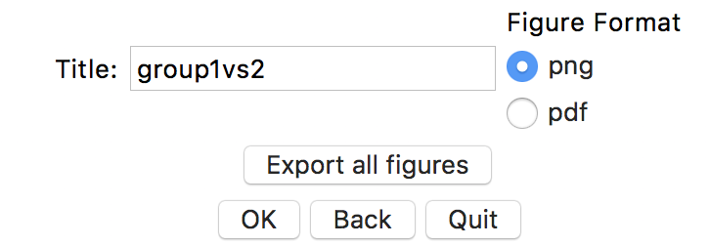
Workflow: Analysis
This page is where you will be spending most of your single cell analysis time in, and is somewhat complicated, so I will split it into five parts (one for each subplot in the window, one for the figure saving which is below)
This window is very long. I will add a scroll bar eventually, but for now, you may have to drag the top bar of the window around to see the plots on the far right if they don’t fit your screen
DO NOT RESIZE THE WINDOW IT CAUSES MAJOR PROBLEMS WITH TKINTER
JUST DRAG THE TOP MENU BAR TO MOVE THE WINDOW AROUND
The part of the window below this description is used to save figures. You can (and should) give a custom title to a figure in (1), which is then appended to the beginning of any plot you save (which you save individually using the “save x plot” button underneath each plot. You can also control whether the figure is saved as a png (lower quality, but faster) or a pdf in (2), or whether to save all 4 plots on the screen at once in (3) (each plot will have a different suffix added to it so they wont just write over each other even if the have the same custom title
(1)
(2)
(3)

Slide 47
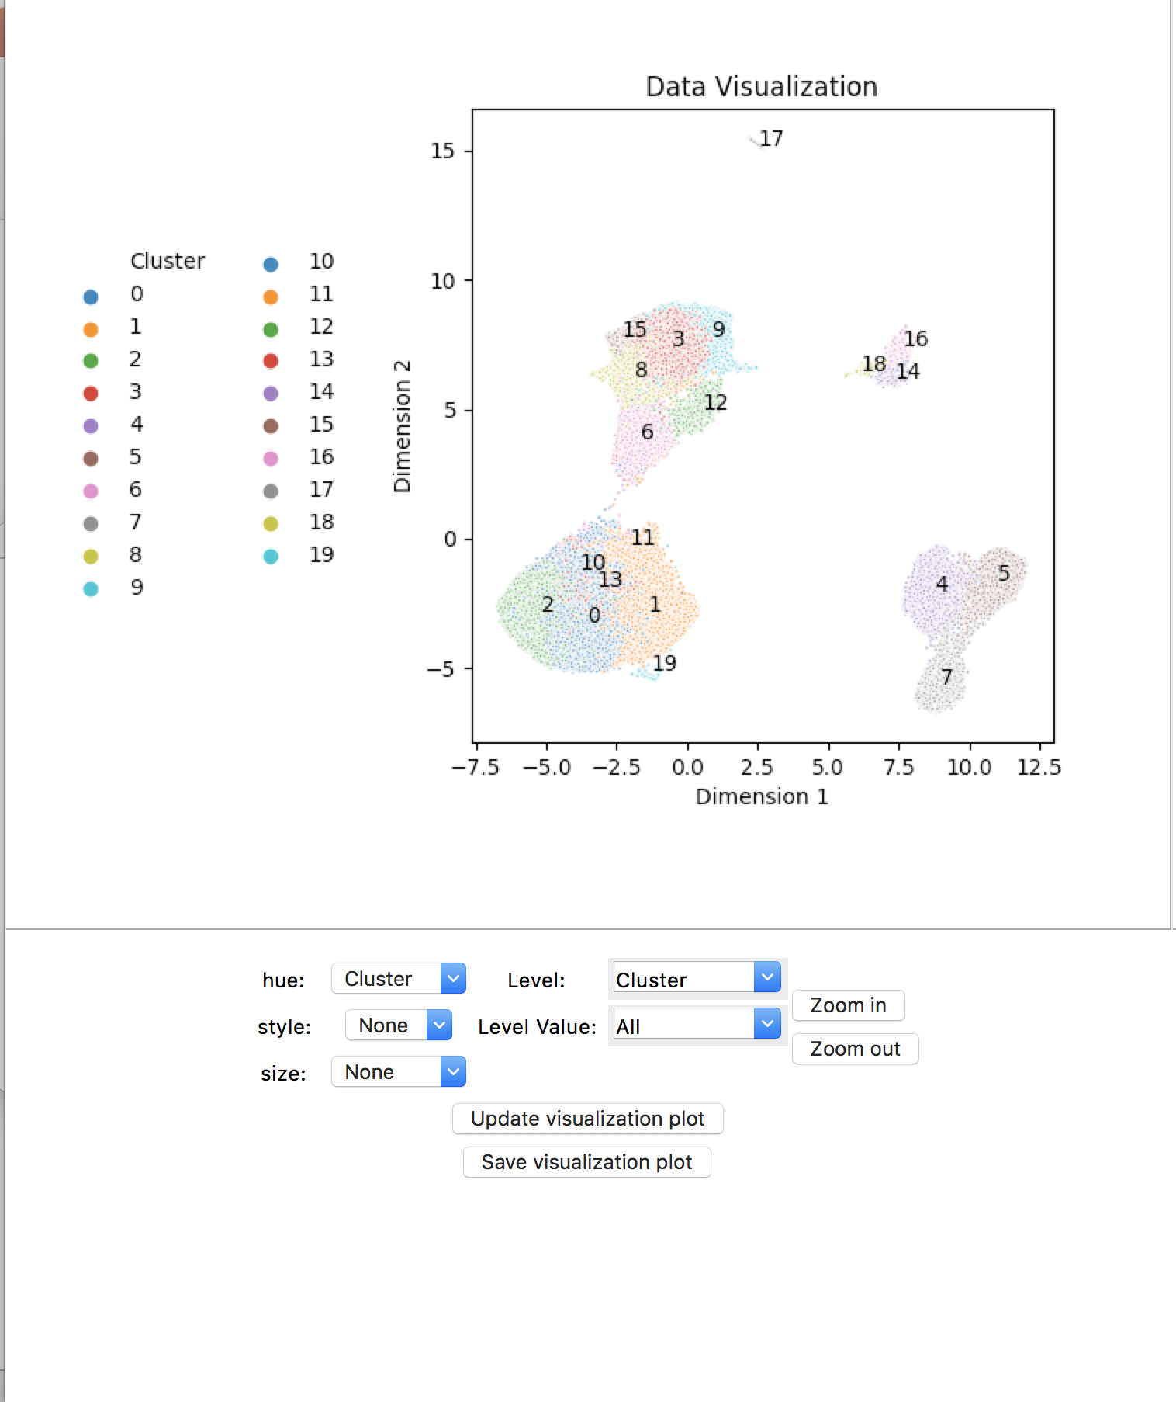
Workflow: Analysis
This window is called the visualization window, and is used to display your data in various ways
You can change the color (hue), style, and size of points on the plot to vary with different levels in your dataset in (1)
Single cell data has so many points that only the hue level is meaningful
You can also color by feature or cluster (default if available)
In (2), you can choose to display only a single level value from a level by using the two dropdowns
For (3), you can click and drag a rectangle within the plot, then click zoom in to zoom into that region
You can do this multiple times
Pressing zoom out resets the view
Whenever you make a change to something (besides zooming) and want to update the plot, you need to press (4) for the change to take place
(5) saves the current plot with the suffix “-visualization”
(2)
(1)
(3)
(4)
(5)

Slide 48
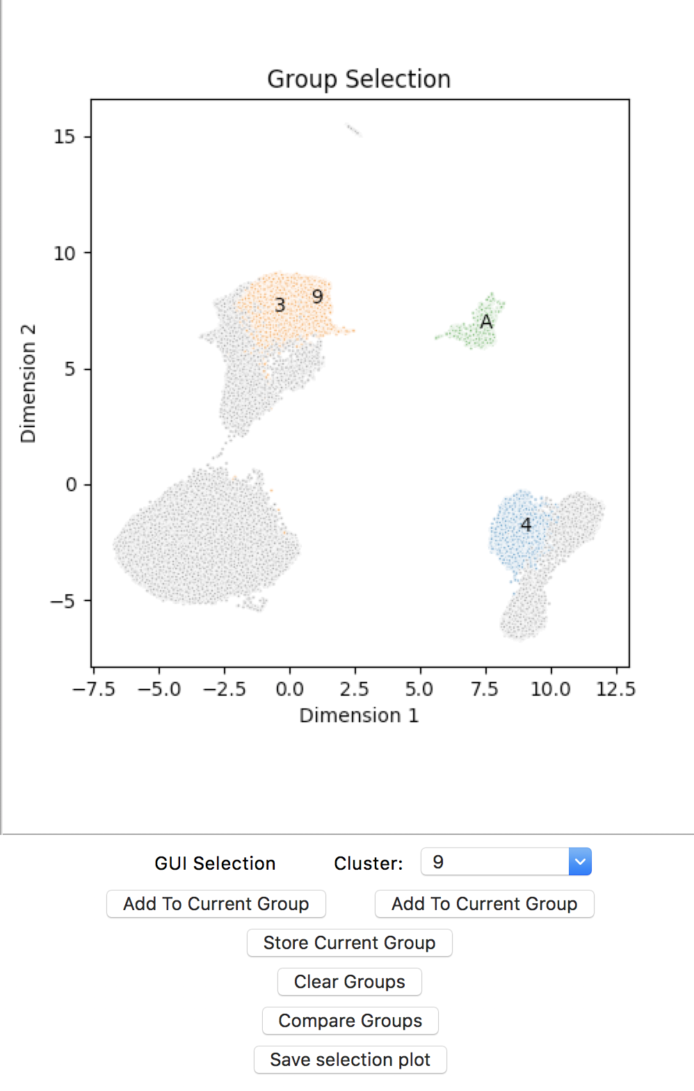
Workflow: Analysis
This window is called the selection window, and is used to select the data you want to compare the phenotypes of
The selections are organized into groups, which can consist of combinations of actual algorithmically defined clusters and hand selections
Each group that has been made will be colored differently
You can add actual clusters to a group by using the dropdown menu (1), and clicking the right hand ”Add to Current Group” (2)
You can add hand selections of data by clicking and dragging a rectangle across a region of the plot, and clicking the left hand “Add to current group” (3)
You can do this multiple times to add multiple selections to a group by clicking add to current group multiple times
In this example, clusters 3 and 9 were both added to the same group (they are colored the same), cluster 4 is in a group by itself, and hand selection A is in a group by itself
You move on to selecting the next group (switching the color as well) by clicking (4), “Store current group”
You clear groups by clicking (5)
If something doesn’t seem to be working, press this and start again
You compare groups that you have selected with (6); this changes the next two plots
You can save this plot (with the suffix “-selection”) using (7)
(1)
(3)
(2)
(4)
(5)
(6)
(7)

Slide 49
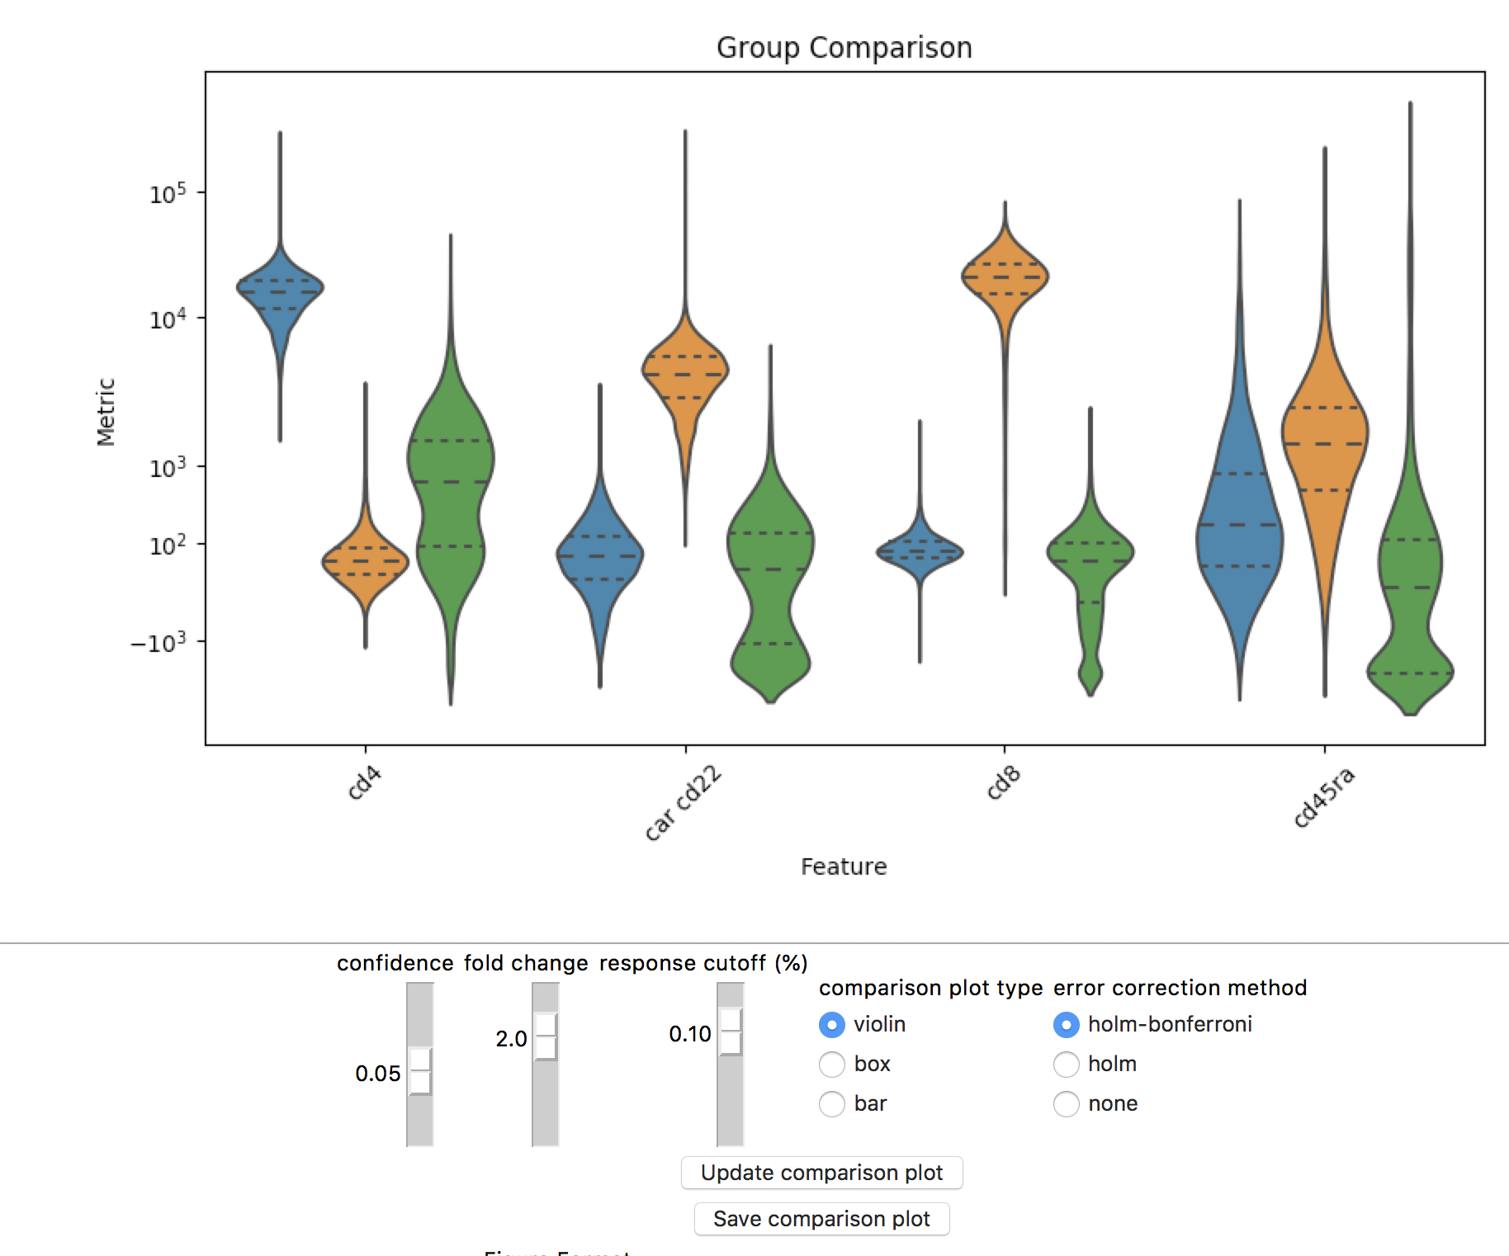
Workflow: Analysis
This window is called the comparison window,; it displays the distributions of features that are different between the groups selected in the previous window that at a specified significance and fold change
The colors in this plot match with the colors of the groups in the previous window
You can adjust the confidence used to calculate significance up or down using slider (1)
I do not recommend making it less stringent
You can adjust the minimum fold change required between the group means/medians to show up on the plot with slider (2)
This is generally the best slider to adjust if you are looking to increase/decrease the number of features that show
You can adjust the minimum percentage of the scale that each group’s mean/median is required to be to show up on the graph (3)
Generally this is the second thing you can make less stringent if you are looking for more features
You can change the type of plot used to show the distributions in (4)
You can adjust the family wise error correction method in (5)
Holm Bonferroni has more statistical power than holm alone but is less stringent
Do not choose no error correction unless you have a very good reason (might even remove this option in the future)
You can update the plot after making changes with (6)
You can save the plot (with the suffix “-comparison”) with (7)
(1)
(3)
(4)
(5)
(2)
(6)
(7)

Slide 50
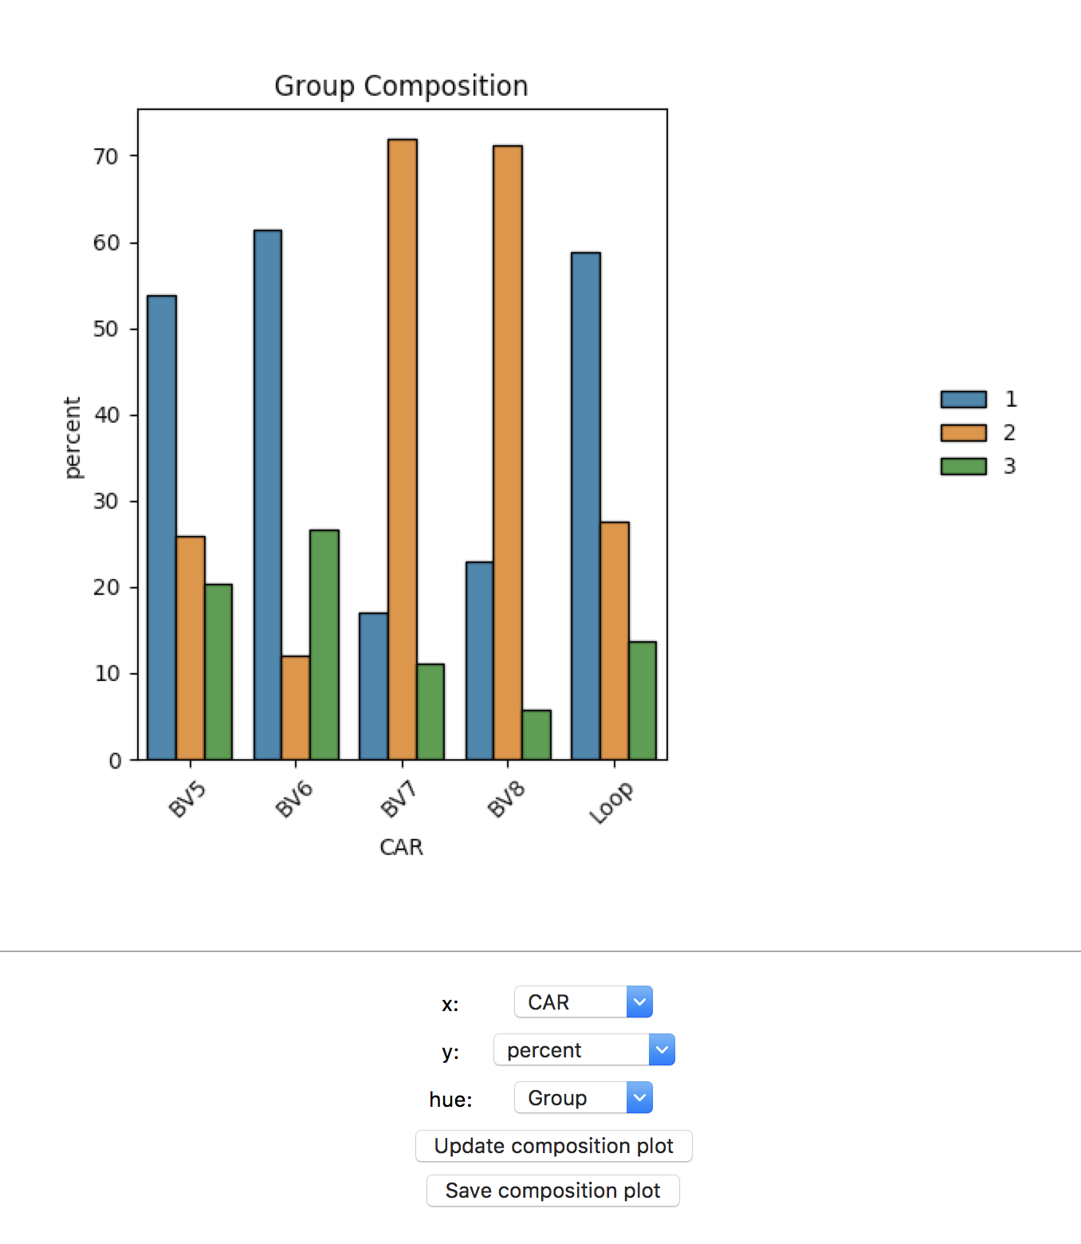
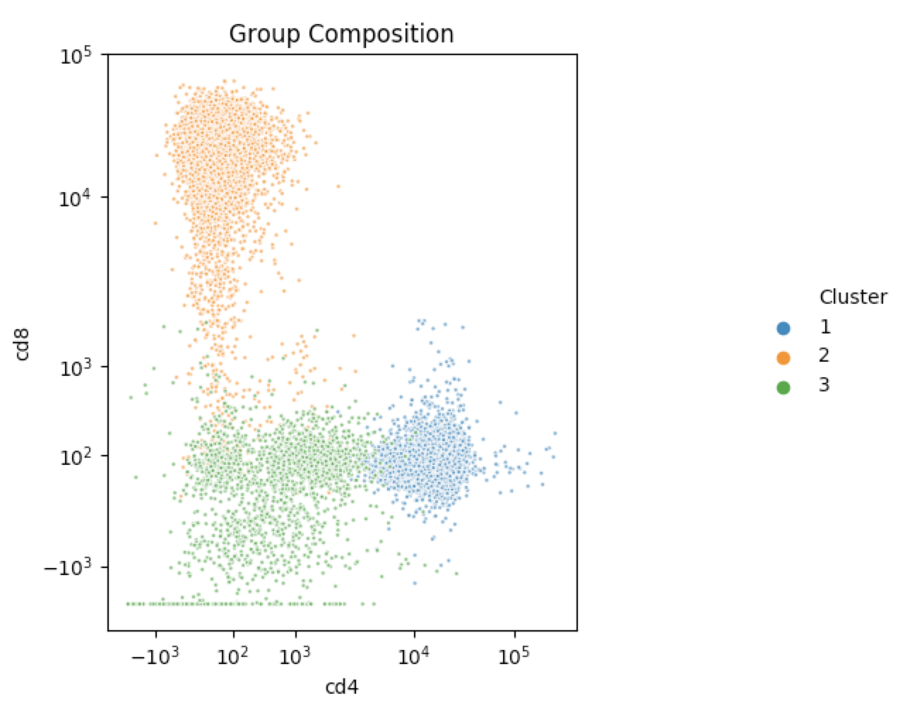

Workflow: Analysis
Group
This window is called the composition window, and it is used to compare the levels of various phenotypes and features across the different groups
The three dropdowns in (1) let you control which levels/features to put on the x and y axis as well as what to color by
In the example A, I put “CAR” on the x axis, and left group as the hue, and put percent on the y axis. This caused the plot to display the percentage of each group within the CARs selected; aka out of all of the BV7 cells in the selection, 70% of them belong to group 2 and so on
This can be used to see what the composition of each cluster in terms of condition is
You can also use this plot to compare the markers in a 2D or 1D form
In example B, I change the x and y axes dropdowns to CD4 and CD8 respectively, and continue coloring by CAR
This lets me see that group 1 is CD4+, group 2 is CD8+, and group 3 is CD4-/CD8-
If I had a feature only on the x axis and frequency on the y axis, it would show a 1 dimensional KDE of whatever feature was on the x axis, colored by group
Button (2) is used to update the composition plot whenever a change is made
Button (3) is used to save the current plot with the suffix “-composition”
(A)
(B)
(1)
(2)
(3)

Slide 51
Final Notes (Analysis)
Remember that the data from each stage of the analysis process (subsetting, dimension reduction, clustering) are all saved in the outputData/analysisFiles subfolders
This means you can easily manipulate them directly outside of the GUI using python if you want
The plots generated from the cluster comparison page will always be in plots
Final Notes (Overall)
I will be updating this GUI as people find bugs that I couldn’t find, so be sure to look out for updates
Let me know if you think there are any features that should be added; I might not be able to do them due to difficulty/time investment but I would still like to hear the ideas
Thanks for trying this; I’ve personally found it very useful for my own projects and I hope it will help simplify your data analysis as well

